Slide 1

MEDICARE
HICAP Overview
A Roadmap to
Understanding
Medicare:
A, B, C and D
by
Carolynn Washington
Education & Outreach Coordinator

Slide 2


What are Your Questions and Concerns?
Truth
Why is Medicare so complicated?
Why do most questions end with “It Depends”

Slide 3
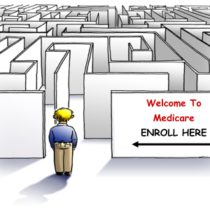
Welcome to Medicare
Navigating Medicare ( It can be complicated)
60,137,923 Individuals on Medicare in the USA
6,146,480 Medicare Beneficiaries in California

Slide 4

HICAP (Health Insurance Counseling and Advocacy Program)
HICAP helps Medicare Beneficiaries become informed consumer to Create Their Own
Individualized Medicare Experience

Slide 5

Things to Consider before COST, When Creating Your Personal Medicare Health Care Plan. It’s a Journey
  What are your health care needs? Are you in
  good health/average/poor?
  Do you have providers that you would like to stay
  with?
  Do you regularly take particular prescription medications?
  Do you need dental, vision, and hearing benefits?

Slide 6

Things to Consider When Creating Your Personal Medicare Health Care Plan. It’s a Journey
  Employment status – are you currently employed or are you retired? Does your employer provide health benefits?
  Do you have other health coverage that you will need to coordinate with Medicare?
  Do you plan to work in your retirement?
  Do you value choice (seeing providers of your own choosing) or convenience (having a network of providers)?
  *Where do you plan to live, now and in the future?
  *Are there recourses in the area to accommodate your needs?
  *Do you plan to travel? Domestic and/or international?
  How much health insurance do you need and
  what are you able and willing to spend?

Slide 7

Frequently Asked Questions about Medicare
What is Medicare and how is it funded?
What is Social Security? How is SSA related to Medicare?
Where can I get help with Medicare issues?
Who is eligible for Medicare?
When can I enroll in Medicare?
What are all the Parts of Medicare (A,B, C & D) and how many Medicare coverage options are there?
How much does Medicare cost?
I’m still working - How do I coordinate my employer’s health coverage with Medicare?
What is the difference between Medicare and Medi-Cal, Covered California, and the Affordable Care Act (ACA)?
Can I be enrolled in both Covered California and Medicare?

Slide 8
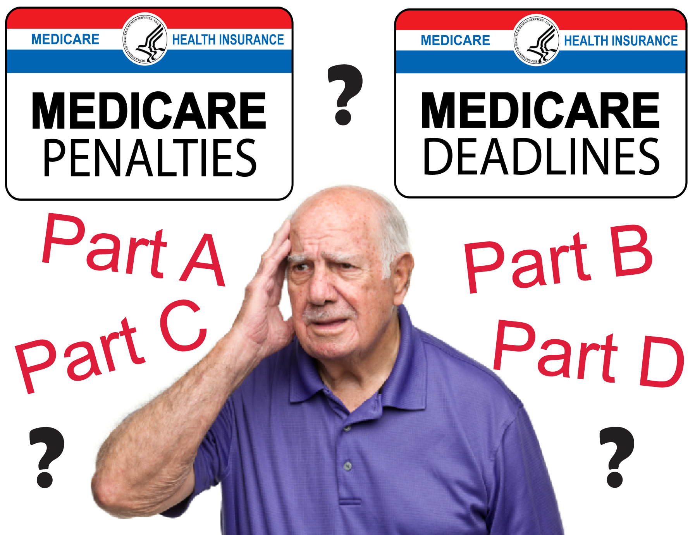
Why are there Medicare Penalties

Slide 9

HICP Presentation Objectives
Creating your Medicare Health Care Plan
Overview Entitlement Programs - Social Security / Medicare
Overview -Legal Services of Northern California (LSNC). HICAP (Health Insurance Counseling & Advocacy Program), a special program of LSNC
HICAP
      Who we serve
      HICAP Counseling Services - Client Advocacy (Grievance and Appeals)
      How Beneficiaries access and utilize our program services
      Understanding Medicare and how it works
      Medicare A,B,C,D, Penalties, Medicare Supplements
      Medicare Enrollment, Medi-Cal
      Medicare Fraud / Abuse
      Medicare Resources
      Volunteer Opportunities
      Review Check List
Notes:
This training is designed to provide basic information about Medicare and other programs. It provides you with resources to help you make informed decisions.
You have choices in how you get your health and prescription drug coverage. Your decisions will affect the type of coverage you get.
The timing of your decisions can be important as well. There are certain decisions that are time sensitive to ensure coverage and avoid late enrollment penalties.

Slide 10

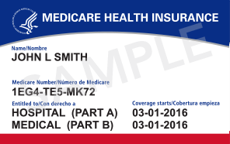
Entitlement Programs Social Security / Medicare
Social Security is largely a pay-as-you-go program. This means that today's workers pay Social Security taxes into the program and money flows back out as monthly income to beneficiaries.
(New Social Security info) press,office@ssa.gov
Medicare is the federal health insurance program for people who are 65 or older, certain younger people with disabilities, and people with End-Stage Renal Disease (permanent kidney failure requiring dialysis or a transplant).

Slide 11
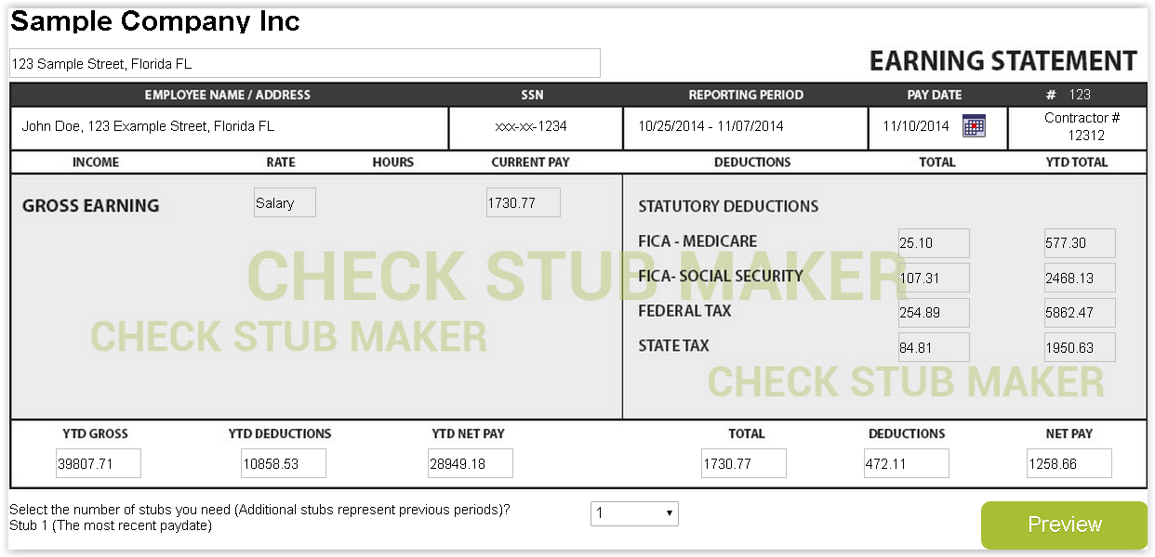
FICA / Social Security / Medicare Trust Fund
Federal Insurance Contributions Act (FICA) tax (/ˈfaɪkə/) is a United States federal payroll (or employment) tax imposed on both employees and employers to fund Social Security and Medicare—federal programs that provide benefits for retirees, disabled people, and children of deceased workers
The Medicare tax rate is 1.45% of an employee's wages. Again, Medicare is an employer and employee tax. You must withhold 1.45% from an employee's pay and employer contribute a matching 1.45%. Together, Medicare makes up 2.9% of the FICA tax rate of 15.3% as of May 7, 2018

Slide 12
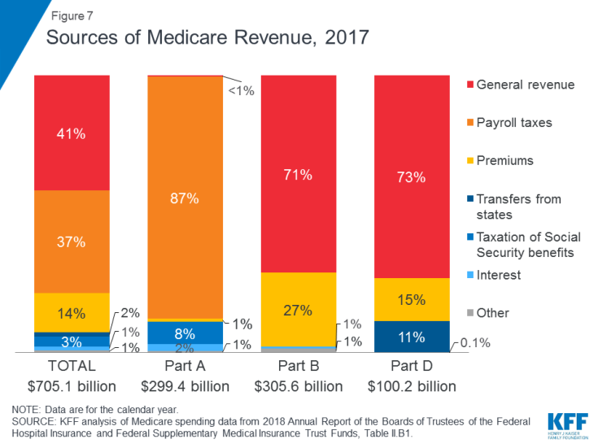
Medicare Funding source
Kaiser Family Foundation web site

Slide 13
Medicare Funding Source breakdown
Part A is funded mainly by a 2.9 percent payroll tax on earnings paid by employers and employees (1.45% each) deposited into the Hospital Insurance Trust Fund. The Part A Trust Fund is projected to be solvent through 2029.
Part B is funded by general revenues and beneficiary premiums
Part C, the Medicare Advantage program, is not separately financed; Medicare Advantage plans provide benefits covered under Part A, Part B, and (typically) Part D, and these benefits are financed primarily by payroll taxes, general revenues, and premiums
Part D is funded by general revenues, beneficiary premiums, and state payments

Slide 14
Where can I get help with my Medicare questions?
Notes:
This training is designed to provide basic information about Medicare and other programs. It provides you with resources to help you make informed decisions.
You have choices in how you get your health and prescription drug coverage. Your decisions will affect the type of coverage you get.
The timing of your decisions can be important as well. There are certain decisions that are time sensitive to ensure coverage and avoid late enrollment penalties.

Slide 15

Legal Services of Northern California (LSNC) provides quality civil legal services in 23 northern California counties. LSNC has been serving the community for over 60 years. LSNC’s mission is to empower the poor to identify and defeat the causes and effects of poverty within our community, efficiently utilizing all available resources.
HICAP Medicare Counseling is a special program of LSNC.
While HICAP provides Medicare counseling only, HICAP counselors may refer other issues to LSNC, including:
  Other kinds of health cases (e.g., bills, Medi-Cal, Covered California, employer coverage) – referred to LSNC Health.
  Housing, public benefits, Social Security cases – referred to LSNC offices.
  Any civil legal matter for seniors in Sacramento – referred to Senior Legal Hotline.
  Pension and retirement issues – referred to Western States Pension Assistance Project at Senior Legal Hotline.

Slide 16



HICAP
Health Insurance Counseling & Advocacy Program
Health Insurance Counseling and Advocacy Program (HICAP) provides free unbiased information to help Medicare beneficiaries and those imminent of Medicare eligibility understand Medicare and decide what’s best for their individual healthcare insurance needs.
Part of a nationwide network of State Health Insurance Assistance Program (SHIP)
Funded by a Federal Grant and State Funds
  Administered by Administration for Community Living (ACL)
  Administered through the California Department of Aging & Agencies on Aging Area 4 – covering Planning & Service Area (PSA) 4, 11, and 29.

Slide 17

HICAP
Health Insurance Counseling & Advocacy Program
Who we serve:
Medicare beneficiaries
regardless of age.
Those imminent of
Medicare eligibility (generally, within 3 months of Medicare eligibility).
Community education – open to the public regardless of age.

Slide 18

HICAP
Health Insurance Counseling & Advocacy Program
Vulnerability of Many Medicare Beneficiaries:
While much of the Medicare population may be considered vulnerable due to a greater need for health care services and higher costs due to age, health status, economic status, or disability, HICAP places special emphasis on identifying and serving those beneficiaries experiencing the greatest barriers to accessing health care.

Slide 19

HICAP
Health Insurance Counseling & Advocacy Program
HICAP Program Overview:
HICAP Services of Northern
California serves 9 counties:
El Dorado, Nevada, Placer, Sacramento, San Joaquin, Sierra, Sutter, Yolo, and Yuba.
HICAP counseling services are FREE and provided by:
HICAP Staff: Managing Attorney, Staff Attorney, Education & Outreach Coordinator, Volunteer Coordinator, Regional Coordinators, Office Manager, and Receptionist.
HICAP Volunteers: Volunteer HICAP Medicare Counselors who are trained and supported by HICAP staff, and registered with the California Department of Aging.

Slide 20

HICAP
Health Insurance Counseling & Advocacy Program
HICAP Services:
HICAP provides free in-depth
individual counseling, advocacy,
and education & outreach on
Medicare benefits, rights, and
options. Common topics include:
  Medicare Part A & Part B
  Medicare “Part C” (Medicare Advantage Plans)
    Health Maintenance Organization (HMO), Preferred Providers Organization (PPO), and Special Needs Plans (SNPs)
  Supplementing Medicare – Medigap policies, Retiree plans, TriCare for Life, VA health benefits
  Medicare Part D
  Low-Income assistance programs: Medicare Savings Programs (MSP), Part D Low Income Subsidy (LIS), and Medi-Cal
  Long Term Care Insurance

Slide 21

HICAP
Health Insurance Counseling & Advocacy Program
HICAP Counseling and Advocacy – common
counseling topics include:
Medicare enrollment
  New to Medicare
  Enrollment Periods
  Medicare premium payment issues, including IRMAA
  (Income Related Monthly Adjustment Amount) for
  beneficiaries with higher annual incomes
Local Medicare health plans and options:
  Medicare planfinder comparisons
  Medicare Advantage plans
  Medicare Supplement (Medi-Gap) policies
  Medicare Part D prescription drug plans
Billing Issues- Provider billing problems
Coordination of Benefits and Recovery issues
Counseling on programs for low-income beneficiaries
  Options for “dual eligibles” (individuals with Medicare & Medi-Cal)
  Screening/enrolling in Low Income Subsidy (LIS)
  Screening for Medicare Savings Programs
Beneficiary rights – appeals & grievances

Slide 22

HICAP
Health Insurance Counseling & Advocacy Program
  HICAP Help for Medicare Appeals and Grievances:
  Clients with complicated issues may be referred to the HICAP Staff Attorney.
  Common types of appeals and grievances include:
    Medicare denials of services or items
    Quality of Care complaints
    General advice on asking for a Medi-Cal fair hearing
    Medicare enrollment issues, Late Enrollment Penalty, IRMAA
      Request for Reconsideration, Equitable Relief
  HICAP and LSNC staff may work together on appeals

Slide 23
For More Information
LSNC (In Sacramento, 916 551-2150)
Medicare & You Handbook
1-800-MEDICARE (1-800-633-4227)
  TTY Users should call 1-87-486-2048
Health Insurance Counseling and Advocacy Program (HICAP)
  800-434-0222 or 916-376-8915
  www.hicapservices.net
Carolynn Washington 916 375-3765
  cwashington@lsnc.net
Notes:
More information and help is available:
The Medicare & You handbook is mailed to each household with Medicare each fall. It includes a list of the Medicare health and drug plans available in your area.
The Medicare helpline is open 24 hours a day including weekends. Call 1-800-MEDICARE (1-800-633-4227). TTY users call 1-877-486-2048.
You can also contact your State Health Insurance Assistance Program (SHIP). Their phone number is on the back cover of your Medicare & You handbook, or get it under Forms, Help, and Resources on www.medicare.gov.
Partners can find information from the CMS National Training Program at http://cms.gov/Outreach-and-Education/ Training/CMSNationalTrainingProgram/ index.html

Slide 24

What is Medicare? 1965
America’s Social Safety Net
Health insurance for people
        65 and older
        Under 65 and receiving SSDI for 24 months
        Any age with End-Stage Renal Disease (ESRD) or Lou Gehrig’s Disease (ALS).
Notes:
President Lyndon Johnson signed the Medicare and Medicaid programs into law July 30, 1965. Medicaid became effective January 1, 1966, and Medicare became effective July 1, 1966. Medicare is the nation’s largest health insurance program, currently covering about 52 million Americans.
Medicare is health insurance for three groups of people:
People who are 65 and older.
People under 65 with certain disabilities who have been entitled to Social Security disability or Railroad Retirement benefits for 24 months.
The 24-month Medicare waiting period does not apply to people disabled by Amyotrophic Lateral Sclerosis (ALS, known as Lou Gehrig’s Disease). People with ALS get Medicare the first month they are entitled to disability benefits. This provision became effective on July 1, 2001.
People of any age who have End-Stage Renal Disease (ESRD), permanent kidney failure requiring dialysis or a kidney transplant.

Slide 25
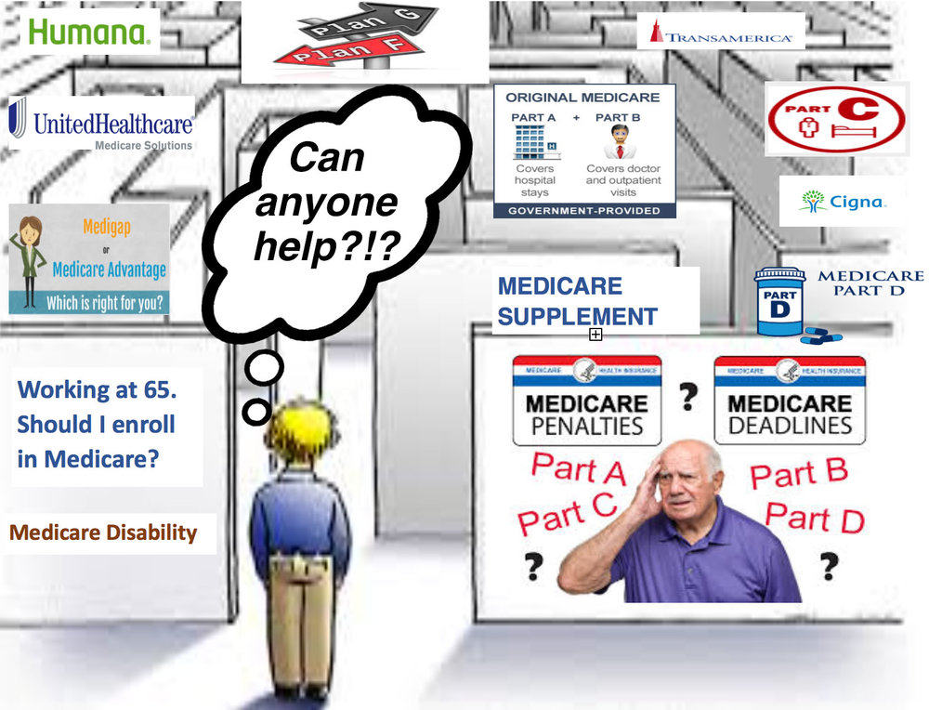
Welcome to Medicare
Some times you don’t know what you don’t know

Slide 26
Roadmap to Success
This is the official U.S. Government Medicare handbook
Medicare Coverage Checklist, Choices & Considerations
Part A
Part B
Medicare Part C
Medicare Part D
Health plans in your area

Slide 27
Medicare Benefits The Four Parts of
Part A Hospital Insurance
Part B Medical Insurance
Part C Medicare Advantage Plans (like HMOs/PPOs) Includes Part A, Part B and sometimes Part D coverage
Part D Medicare Prescription Drug Coverage
Notes:
Medicare covers many types of services, and you have options for how you get your Medicare coverage. Medicare has four parts:
Part A (Hospital Insurance) helps pay for inpatient hospital stays, skilled nursing facility care, home health care, and hospice care.
Part B (Medical Insurance) helps cover medically-necessary services like doctor visits and outpatient care. Part B also covers many preventive services (including screening tests and shots), diagnostic tests, some therapies, and durable medical equipment like wheelchairs and walkers.
Part C (Medicare Advantage) is another way to get your Medicare benefits. It combines Parts A and B, and sometimes Part D (prescription drug coverage). Medicare Advantage Plans (MA) are managed by private insurance companies approved by Medicare. These plans must cover medically-necessary services. However, plans can charge different copayments, coinsurance, or deductibles for these services than Original Medicare.
Part D (Medicare Prescription Drug Coverage) helps pay for outpatient prescription drugs and may help lower your prescription drug costs and protect you against higher costs in the future.

Slide 28




Slide 29

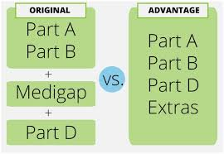
Medicare Questions and Decisions
Original Medicare or Medicare Advantage?
Should I keep/sign up for Part A?
Should I take Part B? When?
What about Part D?
Do I need a Medigap policy?
Can I get help with Medicare costs?
    It Depends.
Notes:
There are some decisions you’ll need to make about your Medicare coverage, including:
Do I want Original Medicare or a Medicare Advantage Plan?
Should I keep/sign up for Part A?
Should I take Part B? When?
What about Part D?
Do I need a Medigap policy?
Can I get help with Medicare costs?

Slide 30
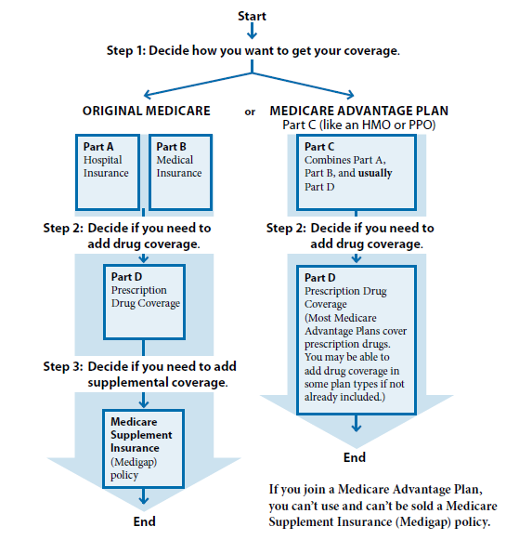

Decide how you want to get your Medicare coverage
Decide how you want to get your Medicare coverage
Source: Page 6 of the Medicare & You handbook
Notes:
Choosing how you get your Medicare coverage is an important decision. There are two main ways you can get Medicare. There is Original Medicare and there are Medicare Advantage Plans, like Health Maintenance Organizations (HMOs) and Preferred Providers Organizations (PPOs). Many of the decisions you need to make will depend on how you choose to get your Medicare health care.
Original Medicare is a fee-for-service program managed by the Federal Government. It provides you with your Medicare Part A and/or Part B benefits. You will be in Original Medicare unless you choose to join another Medicare health plan. About 75% of people with Medicare have Original Medicare. With Original Medicare, you can go to any doctor, supplier, hospital, or facility that accepts Medicare and is accepting new Medicare patients. You use your red, white, and blue Medicare card when you get health care.
Medicare Advantage (MA) Plans are health plan options approved by Medicare. MA Plans are offered in many areas of the country by private companies that sign a contract with Medicare. Medicare pays a set amount of money to plans each month for their members’ health care. If you choose a Medicare Advantage Plan, you still have Medicare and you still get all the regular Medicare-covered services offered under Part A and Part B. You may also get additional benefits offered through the plan, including Medicare prescription drug coverage. However, you may have to use doctors and hospitals that belong to the plan. Benefits and cost-sharing may also be different than in Original Medicare and may vary from plan to plan. If you choose a Medicare Advantage Plan, your plan may give you a card to use when you get health care services and supplies.

Slide 31


Original Medicare
Part A
Part A – Hospital Insurance helps cover:
  Inpatient Hospital Care
  Skilled Nursing Facility care
  Home health care
  Hospice care
Notes:
Medicare Part A (hospital insurance) helps pay for medically necessary inpatient services.
Hospital inpatient care - Semi-private room, meals, general nursing, other hospital services and supplies, as well as care in inpatient rehabilitation facilities and inpatient mental health care in a psychiatric hospital (lifetime 190-day limit).
Skilled nursing facility (SNF) care (not custodial or long-term care) under certain conditions.
Home health care - A doctor, or certain health care providers who work with the doctor, must see you face-to-face to certify that you need home health services. You must be homebound, which means that leaving home is a major effort.
Hospice care – Your doctor must certify that you’re expected to live 6 months or less. Coverage includes drugs for pain relief and symptom management; medical, nursing, and social services; as well as services Medicare usually doesn’t cover, such as grief counseling.
Blood - In most cases, if you need blood as an inpatient, you won’t have to pay or replace it.
Medicare Part B covers medically-necessary outpatient services and supplies.
Doctors’ services - Services that are medically necessary.
Outpatient medical and surgical services and supplies - For approved procedures like X-rays or stitches.
Durable medical equipment (DME) like walkers and wheelchairs.
Preventive services like exams, tests, screening and shots to prevent, find, or manage a medical problem.

Slide 32

Medicare Part A – Is there a Premium?
What does Part A cost?
  Part A is free for most people who have earned 40 quarters (or credits) by paying at least 10 years of Social Security and Medicare payroll taxes (FICA) while working.
  If you have earned less than 40 quarters (have paid FICA for less than 10 years), you can still get Part A if you pay a premium.
    If you don’t enroll when you’re first eligible, you may have a penalty.
Notes:
You usually don’t pay a monthly premium for Part A coverage if you or your spouse paid Medicare taxes while working. This is sometimes called premium-free Part A.
If you aren’t eligible for premium-free Part A, you may be able to buy Part A if:
You’re 65 or older, and you have (or are enrolling in) Part B and meet the citizenship and residency requirements.
You’re under 65, disabled, and your premium-free Part A coverage ended because you returned to work. If you’re under 65 and disabled, you can continue to get premium-free Part A for up to 8 1/2 years after you return to work.
In most cases, if you choose to buy Part A, you must also have Part B and pay monthly premiums for both. The amount of the premium depends on how long you or your spouse worked in Medicare covered employment.
In 2013, the Part A premium for a person who has worked less than 30 quarters of Medicare covered employment is $441 per month. The premium for a person who has worked 30-39 quarters is 45% of that amount, or $243 per month. SSA determines if you have to pay a monthly premium for Part A.
If you aren’t eligible for premium-free Part A, and you don’t buy it when you’re first eligible, your monthly premium may go up 10%. You’ll have to pay the higher premium for twice the number of years you could have had Part A, but didn’t sign up.
If you have limited income and resources, your state may help you pay for Part A and/or Part B. Call Social Security at 1‑800‑772–1213 for more information about the Part A premium. TTY users should call 1-800-325-0778.

Slide 33

Medicare Part A - Premium Costs
If you have earned less than 40 quarters, you can still buy Part A. Your monthly premium depends on how many quarters you have paid Medicare taxes for:
  Less than 30 quarters (full premium)
    $437 per month in 2019.
  Between 30-39 (prorated premium):
    $240 per month in 2019.

Slide 34
Should I Get Part A
Working or Not Most people should enroll in Medicare Part A (Hospital Insurance) when they're first eligible,
The size of the employer determines whether you may be able to delay Part A and Part B without having to pay a penalty if you enroll later.
If the employer has fewer than 20 employees.
You should sign up for Part A and Part B when you're first eligible. In this case, Medicare pays before your other coverage.

Slide 35
Medicare Part A – Deductible
The deductible is the amount you pay before Medicare begins to pay its share.
In 2019, the Part A deductible for inpatient hospital is $1,364.
  The Part A deductible is not an annual fee; it applies to each benefit period. A benefit period begins at hospital admission and ends when the beneficiary has been out of the hospital or skilled nursing facility for 60 consecutive days.

Slide 36

Part A Late-Enrollment Penalty
Part A- If you aren't eligible for premium-free Part A, and you don't buy it when you're first eligible, your monthly premium may go up 10%. You'll have to pay the higher premium for twice the number of years you could have had Part A, but didn't sign up.
Example If you were eligible for Part A for 2 years but didn't sign up, you'll have to pay the higher premium for 4 years. Usually, you don't have to pay a penalty if you meet certain conditions that allow you to sign up for Part A during a special enrollment period.

Slide 37
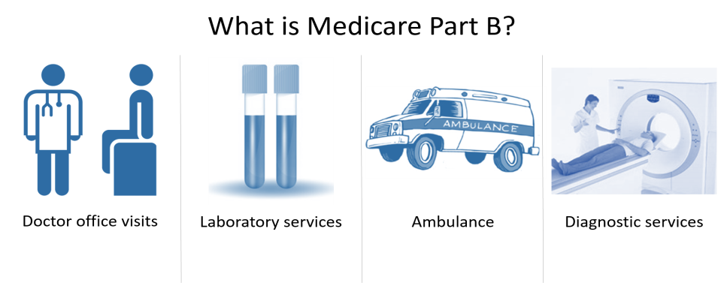

Original Medicare
Medicare Part B – Medical Insurance
Part B – Medical Insurance helps cover:
  Doctor’s visits
  Outpatient medical services
  Clinical lab tests
  Durable Medical Equipment
  Preventive services (see important list in My Medicare and You pg 35)

Slide 38

Medicare Part B – preventive services
You pay nothing for most covered preventive services if you get the services from a doctor or other qualified health care provider who accepts assignment.
However, for some services you may need to pay a deductible, coinsurance or both. These costs may also apply if you get a preventive service in the same visit as a non-preventive service.
Tip: Preventive services are designated with a starting on pg. 30 of Medicare & You 2019.

Slide 39


Medicare Part B – preventive services
Examples of preventive
services include:
Shots:
  Flu shots
  Hepatitis B shots
  Pneumococcal shots
Yearly "Wellness" visit
2019 New Diabetes Prevention Program
Nutrition therapy services
Obesity screenings & counseling
Prostate cancer screenings

Slide 40

Examples of Preventive services
Cardiovascular disease screenings
Cervical & vaginal cancer screening
Colorectal cancer screenings
Depression screenings Diabetes screenings Diabetes self-management training
HIV screening Lung cancer screening

Slide 41

Vision, Hearing, Dental
Original Medicare does NOT cover:
Routine eye exams, eyeglasses or contact lenses.
  Exception: Following cataract surgery that implants an intraocular lens, Medicare Part B helps pay for corrective lenses, one pair of eyeglasses, or one set of contact lenses provided by an ophthalmologist.
Most dental care, dental procedures, or supplies, including cleanings, fillings, tooth extractions, dentures, dental plates, or other dental devices.
  Exception: Medicare Part A may pay for certain dental services that you get when you're in a hospital.
Hearing aids, routine hearing exams, or fittings for hearing aids, regardless of the outcome of the diagnostic test.
Some Medicare Advantage Plans (Part C) may offer extra benefits that Original Medicare doesn’t cover - like vision, hearing, or dental. Contact plans directly for more information.

Slide 42

Medicare Part B – Premium
The standard Part B premium in 2019 is $135.50/month. Most people will pay this amount, including those:
  New to Medicare in 2019,
  Medicare beneficiaries who do not have their Part B premium automatically deducted from their SS benefit, and
  Limited income beneficiaries enrolled in Medi-Cal and Medicare Savings Programs.
Your Part B premium may be higher or lower depending on a variety of factors, including:
  You may have a higher premium if your modified adjusted gross income as reported on your IRS taxes from 2 years ago is over a certain amount. (See next slide.)
  You may have a slightly lower premium if you are already on Medicare, have your Part B automatically deducted from your SS benefits, and the Cost of Living Adjustment (COLA) to your SS benefit was large enough to cover the full Part B premium increase over the previous year. (About 3.5% of Medicare beneficiaries are in this “held harmless” category.)

Slide 43
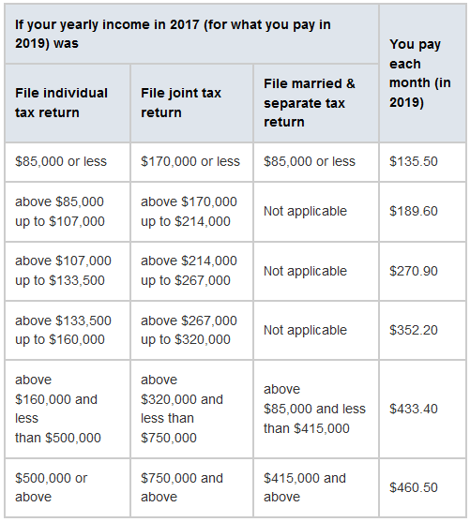
Medicare Part B Premiums

Slide 44
Eligibility & Premium Calculator
https://www.medicare.gov/eligibilitypremiumcalc/#latepenaltycalc
Answer these questions to calculate your Medicare Part B premium.
Fields marked with a red asterisk (*) are required
Disclaimer: This calculator provides an estimate of your Part B premium based on the information that you provide. Social Security (or the Railroad Retirement Board (RRB) if you get benefits from RRB) will notify you of your official premium amount each year.
This calculator can’t estimate your Part B premium if:
You're under 65,
You had Part B before and dropped or lost it,
You enrolled in Part B using a Special Enrollment Period because you or your spouse were working and had group health plan coverage through your or your spouse’s employer or union.
If any of these situations apply to you, contact Social Security (or the RRB) for information about your Part B premium.
Required* Date of birth Month, Year Day Year

Slide 45
Medicare Part B – Deductible & Coinsurance
In Original Medicare, in 2019 you pay:
  Part B annual deductible: $185.
  Part B coinsurance: 20% for most services.
If you have limited income and resources, there may be programs available to help you pay your premiums, deductible, and coinsurance.
Notes:
If you have Original Medicare, you pay the Part B deductible, which is the amount a person must pay for health care each calendar year before Medicare begins to pay. This amount can change every year in January.
After you meet your deductible, you pay some copayments or coinsurance for Part B services. The amount depends on the service, but is typically 20% of the Medicare-approved amount of the service, if the doctor or other health care provider accepts assignment. There’s no yearly limit for what you pay out-of-pocket.
If you can’t afford to pay these costs, there are programs that may help. These programs are discussed later in this presentation.
NOTE: You pay nothing for most preventive services if you get the services from a doctor or other qualified health care provider who accepts assignment. However, for some preventive services, you may have to pay a deductible, coinsurance, or both.

Slide 46
Medicare Part B – Late Enrollment Penalty
In most cases, if you don’t sign up for Part B when you’re first eligible, you may have to pay a Late Enrollment Penalty (LEP).
  The Part B LEP increases your Part B premium by 10% for each 12-month period you delayed enrollment. You will have to pay this penalty for as long as you have Part B.
  For example, if you waited for three years to sign up, your penalty could be 30% of the premium.
  You may also have to wait until the General Enrollment Period (January 1 through March 31) to enroll in Part B. Coverage will start July 1 of that year.
Note: If you have coverage from an employer group health plan based on current employment, you may not have to pay this penalty.

Slide 47
Medicare Enrollment – Should I get Part A and/or B?
Medicare Part A:
  Most people should enroll in Medicare Part A when first eligible, since Medicare Part A is free for most people because they have paid Medicare taxes.
  Some people, including those who contribute to a Health Savings Account (HSA), or who have to pay a premium for Part A, may want to consider delaying enrolling Part A.
Medicare Part B:
  Most people need to enroll in Part B when first eligible. Only people with health insurance from their (or their spouse’s) current employer may be able to delay enrolling in Part B without penalty.
You should always contact your employer or union benefits administrator before delaying Part A and Part B, and to find out how your insurance works with Medicare.
  Your employer coverage may require that you enroll in Part A and Part B in order to get your full coverage.
It Depends

Slide 48

Original Medicare
Part D – Prescription Drug Coverage
Available to all people with Medicare
  If you have Part A and/or Part B.
Provided through private insurances companies:
  Stand-Alone Medicare Part D Prescription Drug Plans, or
  Medicare Advantage Plans with prescription drug coverage.
New for 2019 - Opioid Prescription Limitations
  For safety and cost reasons, plans may place limitations on the opioid prescription drugs covered.
  Consult your plan.
  Ask HICAP for help if you and your doctor agree your prescription is medically necessary, and your plan is denying coverage.
Notes:
Medicare Part D is Medicare Prescription Drug Coverage. Part D coverage is provided through Medicare Prescription Drug Plans (PDPs), Medicare Advantage (MA) Plans, and some other Medicare health plans.

Slide 49

Medicare Part D - 2019 Coverage Gap
2019 Coverage Gap (“Donut Hole”) : $3,820 – $7,653.
  Once you reach the donut hole, you pay 25% for brand-name medication and 37% for generics covered by your plan. Your plan pays the remainder.
  What counts toward getting out of the coverage gap:
    Your deductible, coinsurance, copayments, discount on brand-name drugs, and what you pay in the coverage gap.
Once you're out of the coverage gap, you reach the next phase, called "catastrophic coverage."
  During catastrophic coverage, you pay a small copay or coinsurance.
TIPS:
Review your Explanation of Benefits (EOB) from your plan to track your progress into and out of the coverage gap.
Ask HICAP for help if you think you should be getting a discount.
Calif. law (Senate Bill 393 {2000})Medicare recipients can obtain their prescriptions at a cost no higher than Medi-Cal reimbursement price for drugs.
Make drug plans changes on Medicare.gov website (Plan Finder) & seek preferred Pharmacy

Slide 50
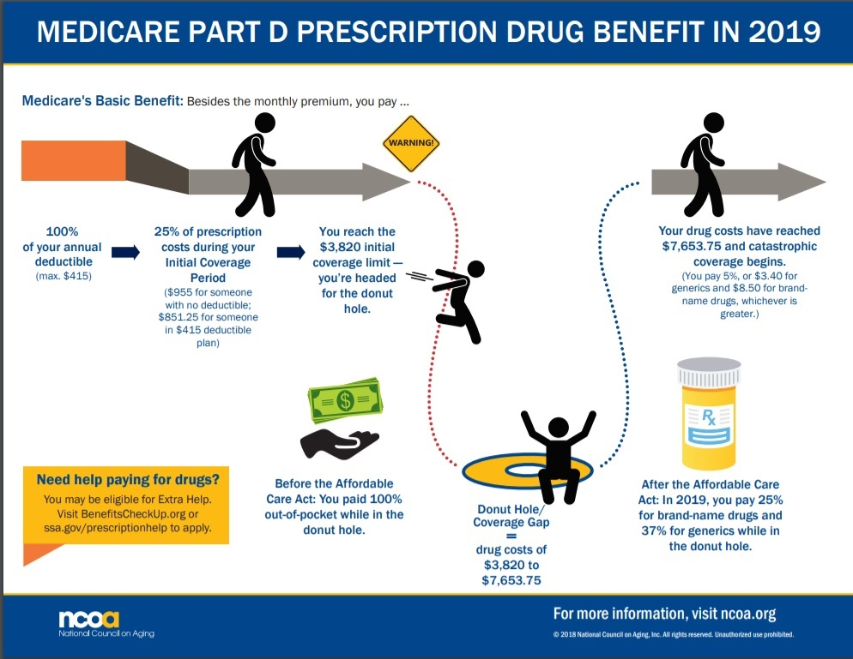
Donut Hole

Slide 51
Medicare Enrollment - Should I get Part D?
How much do my current drugs cost?
What would my Part D costs be?
  Get familiar with Plan Finder on Medicare.gov.
  Ask HICAP for help with an individualized Medicare Part D plan comparison.
How does Medicare Part D work with myr other medical and drug coverage (for example, retiree benefits)?
  Contact your employer or union benefits administrator before enrolling in a Medicare Part D plan, and to find out if and how enrolling in a Medicare prescription drug plan may change your existing coverage.
Do I need to join a Part D plan or do I have other coverage as good as Medicare’s?
  Creditable Prescription Drug Coverage means your prescription drug coverage it is as good or better than Medicare’s. Your plan should send you a Letter of Creditable Coverage every year. Keep these letters. If you do not know if your coverage is creditable, ask your plan. If you have creditable prescription drug coverage,
    It may be to your advantage to keep your current coverage.
    There is no late enrollment penalty if you choose to enroll in Medicare Part D later.
Late Enrollment Penalty (see next slide).
It Depends
Notes:
People who have another source of drug coverage, through a former employer, for example, may choose to stay in that plan and not enroll in a Medicare drug plan. If your other coverage is at least as good as Medicare prescription drug coverage, called “creditable” coverage, you won’t have to pay a higher premium if you later join a Medicare drug plan. Your other plan will notify you to let you know if your coverage is creditable. This notice will explain your options. You can contact your plan’s benefits administrator for more information. Some examples of coverage that may be considered creditable include group health plans (GHPs), State Pharmaceutical Assistance Programs (SPAPs), VA coverage, and military coverage, including TRICARE.
Even if you don’t take many prescriptions now, you should consider joining a Medicare drug plan. If you decide not to join a Medicare drug plan when you’re first eligible, and you don’t have other creditable prescription drug coverage, or you don’t get Extra Help, you’ll likely pay a late enrollment penalty if you join a plan later.
The cost of the late enrollment penalty depends on how long you didn’t have creditable prescription drug coverage. Currently, the late enrollment penalty is calculated by multiplying 1% of the national base beneficiary premium ($31.17 in 2013) times the number of full, uncovered months that you were eligible but didn’t join a Medicare drug plan and went without other creditable prescription drug coverage. The final amount is rounded to the nearest $.10 and added to your monthly premium. Since the national base beneficiary premium may increase each year, the penalty amount may also increase each year. You may have to pay this penalty for as long as you have a Medicare drug plan.

Slide 52

Medicare Part D – Extra Help
The extra help program may help pay for some Medicare Part D prescription drug costs for people with limited income and resources.
You may qualify for extra help for prescription drugs if you:
Have Medicare,
Are enrolled in a Part D plan,
Have monthly or annual income less than
  $1,538/ individual or $2,078/couple.
  Annual income must be limited to $18,210 for an individual ($24,690 for a married couple living together).
Ask HICAP for help applying for extra help, or contact Social Security directly to apply.

Slide 53
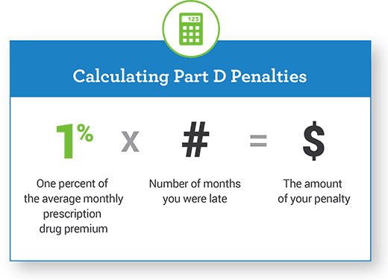
Medicare Part D – Late Enrollment Penalty
  If you are eligible for Medicare Part D, and go without creditable drug coverage for 63 days or more, you may have a Late Enrollment Penalty.

Slide 54


Original Medicare
Medicare Supplement (“Medigap”) Policies:
Fill the gaps in Original Medicare
  Deductibles, coinsurance, copayments
Medicare Supplement Insurance Policies
  Sold by private companies
Standardized plans in all but three states
  Minnesota, Massachusetts, Wisconsin
All plans with same letter
  Have same coverage
  Only the costs are different
California Birthday Rule
Notes:
Medigap (Medicare Supplement Insurance) policies are sold by private insurance companies to help pay for gaps in Original Medicare coverage (like deductibles, coinsurance and copayments). They are private health insurance policies that cover only the policyholder, not the spouse. If you have Original Medicare and a Medigap policy, you can go to any doctor, hospital, or other health care provider that accepts Medicare. Medigap policies may cover certain things Medicare doesn’t depending on the Medigap plan. They must follow Federal and state laws that protect people with Medicare.
In all states except Massachusetts, Minnesota, and Wisconsin, Medigap policies must be one of the standardized Plans A, B, C, D, F, G, K, L, M or N so they can be easily compared. Each plan has a set of benefits that are the same for any insurance company. It’s important to compare Medigap policies, because costs can vary. Each company decides which Medigap policies it will sell and the price for each plan, with state review and approval.
A Medigap policy only works with Original Medicare and does not work with Medicare Advantage (MA) or other Medicare health plans. It’s illegal for anyone to sell you a Medigap policy if you:
Are in a Medicare Advantage Plan (unless your enrollment is ending)
Have Medicaid (unless Medicaid pays for your Medigap policy or only pays your Part B premium)
Already have a Medigap policy (unless you cancel your old Medigap policy)

Slide 55
Medigap Plan Chart
Medigap Benefits | Medigap Plans
 | A | B | C | D | F* | G | K** | L** | M | N
Part A Coinsurance and Hospital Costs (up to an additional 365 days) | 100% | 100% | 100% | 100% | 100% | 100% | 100% | 100% | 100% | 100%
Part B Coinsurance | 100% | 100% | 100% | 100% | 100% | 100% | 50% | 75% | 100% | 100%
Blood (first 3 pints) | 100% | 100% | 100% | 100% | 100% | 100% | 50% | 75% | 100% | 100%
Hospice Care Coinsurance | 100% | 100% | 100% | 100% | 100% | 100% | 50% | 75% | 100% | 100%
Skilled Nursing Coinsurance |  |  | 100% | 100% | 100% | 100% | 50% | 75% | 100% | 100%
Part A Deductible |  | 100% | 100% | 100% | 100% | 100% | 50% | 75% | 50% | 100%
Part B Deductible |  |  | 100% |  | 100%
Part B Excess Charges |  |  |  |  | 100% | 100%
Foreign Travel Emergency (Up to Plan Limits) |  |  | 80% | 80% | 80% | 80% |  |  | 80% | 80%
 |  |  |  |  |  |  | Out-of-pocket limit in 2019
 |  |  |  |  |  |  | $5,560 | $2,780
*Plan F has a high-deductible option
Notes:
All Medigap policies cover a basic set of benefits, including:
Medicare Part A coinsurance and hospital costs up to an additional 365 days after Medicare benefits are used up
Medicare Part B coinsurance or copayment
Blood (First 3 Pints)
Part A Hospice Care coinsurance or copayment
In addition, each Medigap Plan covers different benefits:
The skilled nursing facility care coinsurance is covered by Medigap Plans C, D, F, G, K (at 50%), L (at 75%), M and N
The Medicare Part A deductible is covered by Medigap Plans B, C, D, F, G, K (at 50%), L (at 75%), M (at 50%), and N
The Medicare Part B deductible is covered by Medigap Plans C and F
The Medicare Part B excess charges are covered by Medigap Plans F and G
Foreign travel emergency costs up to the plan’s limits are covered by Medigap Plans C, D, F, G, M and N
Plan F also offers a high-deductible plan.
Plans K and L have out-of-pocket limits of $4,940 and $2,470 respectively in 2015.

Slide 56
Medigaps – Changes in 2020
After January 1, 2020, Medicare Supplement policies that provide coverage of the Part B deductible (Plan C and Plan F) may not be sold or issued to a newly eligible Medicare beneficiaries.
  That means people with birthdays of December 31, 1954 (turning 65 on December 31, 2019) may be the last group able to enroll in Medicare Supplement Plan C or F.
  Those eligible for Medicare after January 1, 2020 will no longer have the option of Medigap Plan C or Plan F.
If you already have Plan C or Plan F, you can keep it. The law only affects new enrollees (those eligible for Medicare on January 1, 2020 or later).

Slide 57

Medigaps – California Dept. of Insurance
The California Department of Insurance regulates Medicare Supplement (Medigap) polices.
Compare sample rates at DOI’s website www.insurance.ca.gov
  Seniors
    Health coverage
      Guide to Medicare Supplement
        Medicare Supplement Insurance Rates Survey

Slide 58
Decide how you want to get your Medicare coverage
Decide how you want to get your Medicare coverage
Source: Page 6 of the Medicare & You handbook
Notes:
Choosing how you get your Medicare coverage is an important decision. There are two main ways you can get Medicare. There is Original Medicare and there are Medicare Advantage Plans, like Health Maintenance Organizations (HMOs) and Preferred Providers Organizations (PPOs). Many of the decisions you need to make will depend on how you choose to get your Medicare health care.
Original Medicare is a fee-for-service program managed by the Federal Government. It provides you with your Medicare Part A and/or Part B benefits. You will be in Original Medicare unless you choose to join another Medicare health plan. About 75% of people with Medicare have Original Medicare. With Original Medicare, you can go to any doctor, supplier, hospital, or facility that accepts Medicare and is accepting new Medicare patients. You use your red, white, and blue Medicare card when you get health care.
Medicare Advantage (MA) Plans are health plan options approved by Medicare. MA Plans are offered in many areas of the country by private companies that sign a contract with Medicare. Medicare pays a set amount of money to plans each month for their members’ health care. If you choose a Medicare Advantage Plan, you still have Medicare and you still get all the regular Medicare-covered services offered under Part A and Part B. You may also get additional benefits offered through the plan, including Medicare prescription drug coverage. However, you may have to use doctors and hospitals that belong to the plan. Benefits and cost-sharing may also be different than in Original Medicare and may vary from plan to plan. If you choose a Medicare Advantage Plan, your plan may give you a card to use when you get health care services and supplies.

Slide 59

Medicare Part C – Medicare Advantage
Must have both Part A & Part B to enroll.
Health plan options (HMO, PPO) offered by private insurance companies
  Approved by Medicare
  Alternative to Original Medicare
  Still part of the Medicare program
Medicare pays plan an amount for each member’s care. Capitation model
May have to use network doctors or hospitals.
Protocols
Types of plans available may vary by area.
Notes:
Medicare Advantage Plans are health plan options approved by Medicare and run by private companies. Medicare Advantage is also called Part C.
Medicare Advantage Plans are part of the Medicare program; they are just another way to get Medicare coverage.
Medicare pays the plan a certain amount for each member’s care.
If you join a Medicare Advantage Plan, you may have to use a network of doctors and/or hospitals.
There are six main types of Medicare Advantage Plans. Not all types of plans are available in all areas.
Medicare Health Maintenance Organization (HMO) Plans
Medicare Preferred Provider Organization (PPO) Plans
Medicare Private Fee-for-Service (PFFS) Plans
Medicare Special Needs (SNP) Plans
HMO Point-of-Service (HMOPOS) Plans
Medicare Medical Savings Account (MSA) Plans

Slide 60
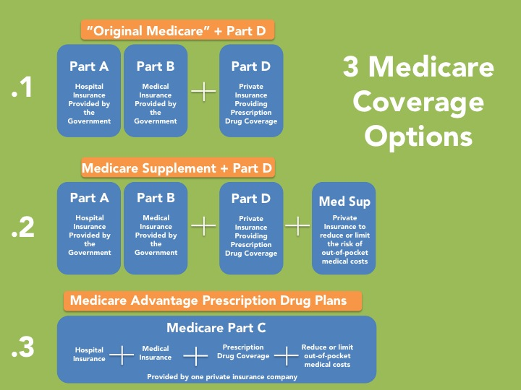
Medicare Coverage Options

Slide 61


Medicare and Other
Health Insurance
Coordinating Benefits
Will the plan pay differently after I have paid a certain amount of out-of-pocket expenses each year?
Does the plan pay for services Medicare does not cover, such as dental care, eyeglasses and hearing aids?
If I move, will I be required to change plans or is it optional?
If I change plans after I move, how much time do I have to do so?
Will my spouse be covered under this plan if I leave the plan, even if he/she is younger than age 65?
Will my spouse still be covered if I die? For how long?

Slide 62

Medicare and Other
Health Insurance
Coordinating Benefits
How does my retiree plan coordinate with Medicare?
Do I have a choice of retiree plans or is there only one plan? If I have a choice, when can I exercise it?
What parts of Medicare am I required to pick up - A, B, C, D?
Do I need a Part D Plan for prescription drugs or is that benefit included in my retiree plan? If it is included, is the plan’s prescription drug benefit creditable?
Do I need to meet any deductibles before benefits will be paid? If so, does a deductible apply to some or all of the plan’s benefits
Who pays first? (Your guide to who pays first – Medicare.gov)

Slide 63

Medicare Enrollment
How to enroll
When to enroll
Where to enroll

Slide 64

10,000 Baby Boomers a day

Slide 65

Medicare Enrollment - How
Automatic Enrollment for those receiving:
  Social Security benefits
  Railroad Retirement Board benefits
If you are automatically enrolled, you will receive an Initial Enrollment Period Package
  3 months before:
    Age 65, or
    The 25th month of receipt of disability benefits.
  Includes your Medicare card
    New Medicare Cards (April 2018).
Notes:
If you’re already getting Social Security benefits (for example, getting early retirement) you’ll automatically be enrolled in Medicare Part A and Part B without an additional application. You’ll get your Initial Enrollment Period Package, which includes your Medicare card and other information, about 3 months before you turn 65 (coverage begins the first day of the month you turn 65), or 3 months before your 25th month of disability benefits (coverage begins your 25th month of disability benefits).
If you’re not getting retirement benefits from Social Security or the Railroad Retirement Board you must sign up to get Medicare. We’ll talk about the periods when you can enroll later.
NOTE: Welcome to Medicare, CMS Product No. 11095 is pictured on this slide. It is part of the Initial Enrollment Period Package.

Slide 66

Medicare Enrollment - How
If enrollment is not automatic (for example, because you are still working, or you are delaying receiving SS benefits),
  Most will need to enroll at Social Security by:
    Visiting your local SSA office, or
    Calling 1-800-772-1213, or
    Online at www.socialsecurity.gov.
  If you are a Retired Railroad employee,
    Call your local RRB office or 1‑877‑772‑5772.
Notes:
If you aren’t getting Social Security or Railroad Retirement Board (RRB) benefits (for instance, because you’re still working), you’ll need to sign up for Part A (even if you’re eligible to get it premium-free). You should contact Social Security 3 months before you turn 65. If you worked for a railroad, contact the RRB to sign up.
Social Security advises people to apply for Medicare benefits 3 months before age 65. You don’t have to be retired to get Medicare. The full retirement age for Social Security retirement benefits is now 66 (for persons born between 1943 and 1954) and will gradually increase to 67 for persons born in 1960 or later. However, you can still receive full Medicare benefits at age 65.

Slide 67

Medicare Enrollment – When
Initial Enrollment Period (IEP)
You don’t have to be retired
Lasts 7 months
  Begins 3 months before your 65th birthday
  Includes the month you turn 65
  Ends 3 months after you turn 65
  You may pay a late enrollment penalty penalty and experience a gap in coverage if you delay
There are other qualifying times you may enroll
Notes:
If you’re not automatically enrolled, you can choose to sign up for Part B during your Initial Enrollment Period (IEP).
You can sign up for Part B any time during your 7-month IEP that begins 3 months before the month you become eligible for Medicare. You can choose whether or not to enroll in Part B. If you enroll in Part B, you pay a monthly premium.
Sign up during the first 3 months of your IEP to get your Part B coverage effective the month you turn 65. If you wait to sign up until the last four months of your IEP, your Part B start date will be delayed.
There are other times you may enroll, but you may have to pay a penalty if you delay.
NOTE: If your birthday is the first day of the month, your coverage will start the first day of the prior month if you apply within the first 2 months of your IEP.

Slide 68
Medicare Enrollment – When
  Medicare Enrollment Periods:
  Initial Enrollment Period (IEP) - At age 65, or disabled at any age and in the 25th month of receiving SSDI, or at any age with End-Stage Renal Disease (ESRD) or Lou Gehrig’s Disease (ALS).
General Enrollment Period (GEP) - January 1st - March 31st if you have to buy Part A and B If you missed your Initial Enrollment Period you get another chance, coverage would begin on July 1st of the same year.

Slide 69
Medicare Part C and Part D Enrollment - When
Annual Election/Open Enrollment Period (AEP): Oct 15th – Dec 7th is the annual Open Enrollment for Medicare Advantage and Medicare Part D plans, for coverage starting January 1 the following year. Plans change every year. Premiums could increase, drug costs might increase. Like all insurance, not all health plans are priced the same and not all plans have the same coverage.
(New for 2019) Medicare Advantage Open Enrollment Period: Jan 1st – March 31st
  Medicare Advantage (MA) enrollees can switch from their MA Plan to:
    Another Medicare Advantage plan, or
    Original Medicare + Part D Prescription Drug Plan.
  * Special Enrollment Periods: Vary
  Examples: Affected by the California wildfires, join a plan if you move, lose your employer health coverage, lose your prescription drug coverage, switching to a 5 star Medicare Advantage plan, or have both Medicare and Medicaid. Ask HICAP for help if you have questions on if you qualify for a Special Enrollment Period as not all examples are listed above
5-star special enrollment period-Plans and health care providers with 5-star ratings.
  You can only switch to these plans once from Dec8-Nov 30
  .5-

Slide 70
Medicare Enrollment 2019 Tips
Starting in 2019, the Special Enrollment Period (SEP) for Dual-Eligible and Extra Help recipients will be limited to one plan change per quarter during the first 9 months of the year.
If new to Medicare, contact Medicare.gov for updates to changes affecting Medicare.
Watch your mail for notices from your plans indicating any changes. (They should notify you of any changes.)
Be proactive: Contact your plan to review your benefits to make sure they will continue to meet your needs.
Review your Medicare Summary Notices
Last, but not least, review your Medicare and You Book yearly!

Slide 71

Medicare Savings Programs
Medicare Savings Programs help low-income individuals with some of the out-of-pocket costs for Medicare, including Medicare Part A and Part B premiums, deductibles, copayments, and coinsurance.
There are four types of Medicare Savings Programs: Qualified Medicare Beneficiary (QMB) Program, Specified Low-Income Medicare Beneficiary (SLMB) Program, Qualifying Individual (QI) Program, and Qualified Disabled and Working Individuals (QDWI) Program. Benefits vary for each program, but all of them, with the exception of the QDWI Program, help pay for Medicare Part B premiums.
To qualify, you must have both Medicare Part A and Part B and have income and resources below a certain threshold. The income and resource requirements are different for each of the four Medicare Savings Programs and may change from year to year.
Notes:
Medicare Savings Programs provide help from Medicaid paying Medicare costs, including Medicare premiums, deductibles, and/or coinsurance. Medicare Savings Programs often have higher income and resource guidelines than full Medicaid. The income and resource guidelines may change each year.
In most cases, to qualify for a Medicare Savings Program in 2015, you must have:
Part A
Monthly income less than $1,505/monthly or $18,060/annual—one person
Monthly income less than $2,023/monthly or $24,270— married and living together
Many states figure your income and resources differently, so you may qualify in your state even if your income or resources are higher than the amounts listed above. If you have income from working, you may qualify for benefits even if your income is higher than the limits above.
Please see Appendix A for more information about the income guidelines for Medicare Savings Programs.
NOTE: Resources include money in a checking or savings account, stocks, bonds, mutual funds, and Individual Retirement Accounts (IRAs). Resources don’t include your home, car, burial plot, burial expenses up to your state’s limit, furniture, or other household items. Some states don’t have any limits on resources.

Slide 72
Screening for Medicare Savings Programs
Medicare Savings Programs (MSPs) are a category of Medi-Cal eligibility that help with Medicare costs (Part A and Part B premiums, deductibles, coinsurance)
Eligibility criteria and benefits differ depending on the type of MSP:
  Qualified Medicare Beneficiary (QMB)
  Specified Low Income Medicare Beneficiary (SLMB)
  Qualified Individual (QI)
  Qualified Working Disabled Individual (QDWI)
Higher resource limit than for Medi-Cal
Automatic eligibility for extra help with Medicare Part D prescription drug costs.
Ask HICAP for help if you think you might qualify for a Medicare Savings Program.
Notes:
Medicare Savings Programs provide help from Medicaid paying Medicare costs, including Medicare premiums, deductibles, and/or coinsurance. Medicare Savings Programs often have higher income and resource guidelines than full Medicaid. The income and resource guidelines may change each year.
In most cases, to qualify for a Medicare Savings Program in 2015, you must have:
Part A
Monthly income less than $1,345 and resources less than $7,080—one person
Monthly income less than $1,813 and resources less than $10,620— married and living together
Many states figure your income and resources differently, so you may qualify in your state even if your income or resources are higher than the amounts listed above. If you have income from working, you may qualify for benefits even if your income is higher than the limits above.
Please see Appendix A for more information about the income guidelines for Medicare Savings Programs.
NOTE: Resources include money in a checking or savings account, stocks, bonds, mutual funds, and Individual Retirement Accounts (IRAs). Resources don’t include your home, car, burial plot, burial expenses up to your state’s limit, furniture, or other household items. Some states don’t have any limits on resources.

Slide 73

Medicare (for People with Medi-Cal)
Medi-Cal, the Medicaid program in California, provides health coverage to people with low-income and asset levels who meet certain eligibility requirements.
People with both Medicare and full Medi-Cal are known as "dual eligibles" or "Medi-Medis.”

Slide 74
Medicare (for People with Medi-Cal)
If you have both Medicare and Medi-Cal,
  Medicare is the primary payer (meaning Medicare will pay first for Medicare-covered benefits) and
  Medi-Cal is the secondary payer.
Medi-Cal will only cover these costs and services if you use providers that accept Medi-Cal.
If you qualify for full Medi-Cal, Medi-Cal will also pay your monthly Medicare Part B premium and help with deductibles and copayments.

Slide 75
HICAP Assistance for “Dual Eligibles”
Counseling for people with Medicare and Medi-Cal
Common Medi-Cal programs for Medicare beneficiaries
  SSI linked Medi-Cal
  Medi-Cal Aged & Disabled Federal Poverty Level Program
  Medi-Cal Aged, Blind & Disabled Medically Needy (SOC)
  Medi-Cal 250% Working Disabled Program
How Medi-Cal helps people with Medicare
  State pays Medicare Part B premium (State Buy-In)
  Automatically qualify for Low Income Subsidy for Part D costs
    Continuous Special Enrollment Period to change Medicare health and drug plans
Coverage options for dual eligibles
General information on Medi-Cal rights and responsibilities
  HICAP works with LSNC-Health unit 1888 354-4474

Slide 76


Senior Medicare Patrol: Fighting Medicare Fraud
Funded by the U.S. Department of Health & Human Services - Administration on Community Living / Administration on Aging
https://www.youtube.com/watch?v=YJcOLpYNlWc
Notes:
Where are they with the HICAP training – which module?
Welcome participants to this professional development training on SMP Foundations
Introduce myself
Have Volunteers introduce themselves
name
why interest in HICAP and SMP
Explain the Training materials from the SMP Volunteer Foundations Manual
Chapters 1 and 3 (chapter 2 is about Medicare Basics – Can’t get a better expert than Sandy to explain about that)
76
Chapter 1

Slide 77
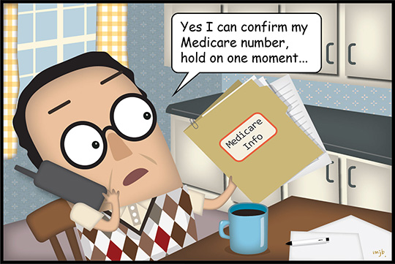
Focus on Education / Awareness
SMPs empower and assist Medicare beneficiaries, their families and caregivers to prevent, detect, and report health care fraud, errors, and abuse through outreach, counseling and education
Protect Detect Report

Slide 78
Focus on Education / Awareness
SMPs empower and assist Medicare beneficiaries, their families and caregivers to prevent, detect, and report health care fraud, errors, and abuse through outreach, counseling and education
Protect, Detect, Report
  www.cahealthadvocates.org
  www.smpresource.org

Slide 79

Why Do We Care?
Every year, Medicare loses billions of dollars
Fraud can be dangerous to your health!
You may be labeled an ‘over-utilizer’:
  You may lose access to care and benefits
  You may be unable to get needed equipment
  All taxpayers lose
Notes:
Here the speaker will introduce to the participant that not only does Medicare fraud impact the Federal benefit, but if a beneficiary is found to be complicit in fraud, they can find that their claims are being denied, or they will not be able to access necessary Medical Equipment.
Example- If you are in need of a wheelchair, but Medicare records indicate that you have already received a wheelchair, you will not be able to receive one until the issue can be resolved. This can take valuable time.

Slide 80
Answers
How much does Medicare pay out annually in claims? $575.5 billion
  _____________________________
How much of this is estimated to be lost to fraud and abuse? $60-90 billion
  _____________________________
What is the #1 state for losses due to Medicare and Medicaid fraud and abuse? CA
  _____________________________
#2, #3, #4 states? Florida, Texas, New York
                Source: Congressional Business Office (CBO) for 2012
Notes:
2012 statistics
5,000,198 Medicare beneficiaries in California
$575.5 BILLION paid annually in claims
$60 to $90 billion every year lost to fraud and abuse
1 California
2 Florida
3 Texas
4 New York

Slide 81
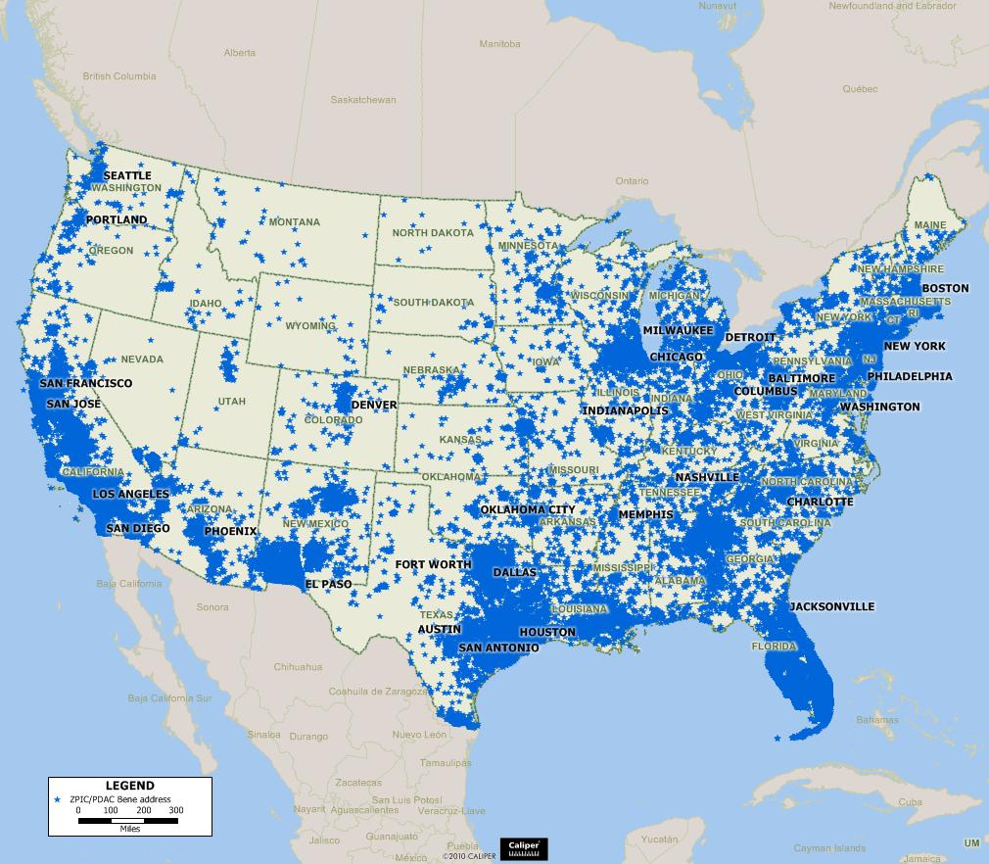
Identity Theft is the Door to Medicare Fraud
- Compromised Beneficiaries
Notes:
Prevalence of identity theft maps to Medicare fraud
How does fraud occur?
Identity theft – someone has to have your medicare number in order to submit fraudulent claims

Slide 82

Some Common Schemes
Medicare Card Fraud- Cost to activate your card, Send a plastic new card
Durable Medical Equipment- Brace Scam
Enrollment Fraud-Agents misrepresents plans, offers trips, DME, must sign up or lose Medicare
Doctor, Medical Facility, Lab, Pharmacy
  Billing for services not received
  Providing a service; billing for a more expensive procedure
  Double billing
Allegations of Agent Misconduct & Plan Marketing Violations via TV commercials, mail, telephone or in-person
  Misrepresentation - says they are from Medicare or that Medicare wants a person to have a certain service
Questionable Hospice Enrollments
Notes:
82

Slide 83
Common Fraud Areas
Ambulance Services
Clinical Lab/Independent Physiology Labs
Durable Medical Equipment (DME) Suppliers
Home Health Agencies
Hospice Care
Hospital Services
Medicare Advantage / Managed Care Plans
Medicare Prescription Drug Plans
Mental Health Services
Nursing Facilities
Physician/Practitioner Services & Kickbacks
Notes:
Trending over time
When law enforcement comes down on one aspect, another fraud scheme pops up
Approximately 16 payment manuals for Medicare covered services
“It depends”

Slide 84
Senior Medicare Patrol (SMP) Suggests a 3 Step Approach
Step 1
PROTECT
Step 2
DETECT
Step 3
REPORT
Notes:
The Senior Medicare Patrol uses a three-step approach to Medicare fraud education:
Step 1: protect your Medicare number. Fraudulent claims against your Medicare number can only occur if someone knows that number.
Step 2: detect possible fraud by carefully inspecting Medicare Summary notices and other statements to make sure that they are for services that you indeed received.
Step 3: Report fraud and abuse (even if you just think something is amiss)

Slide 85

Step 1: PROTECT
Your Medicare card is your healthcare card
Protect it like you do your credit card
=
Notes:
To protect yourself, treat your Medicare card like you treat your credit cards. Do not give out the number to anyone other than your doctor.

Slide 86
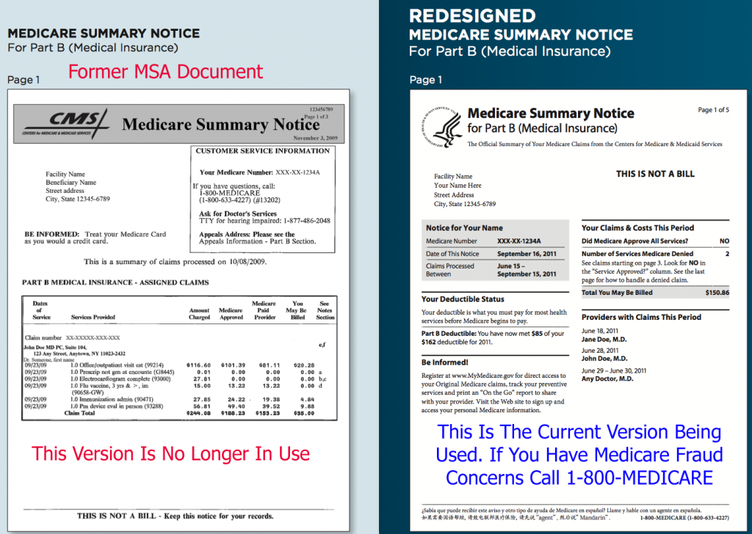
Step 2: DETECT
Read your Medicare Summary Notice as you would your credit card statement
Your Medicare Summary Notice is a statement of what Medicare paid to providers who billed your Medicare Number
Read it carefully
Report suspicious charges
Notes:
Carefully review your Medicare Summary Notice and other statements.

Slide 87
Step 3: Report Fraud
Call the SMP Hot Line - (855) 613-7080
Or 1(800) MEDICARE (633-4227)
Or call HICAP 1(800-434-0222)
We may need
  Description of the situation
  Name of provider involved
  Name(s) of Beneficiary involved
  Supporting Documentation
    Medicare Summary Notices, etc.
Notes:
The Senior Medicare Patrol has a Medicare fraud hotline – keep this number by your telephone.
Even if you are just a bit suspicious, call us. It only takes one person to point out potential fraud.

Slide 88

Resources
http://www.medicareadvocacy.org
Medicare Legislative Updates
Medicare Skilled Nursing Facility (SNF) Coverage
Medicare: Myths and Realities
Nursing Home Residents Rights
Part B Coverage
Part D Prescription Drug Coverage
Rights of Individuals Eligible for Both Medicaid and Medicare (Dually Eligible)

Slide 89
Resources- JUSTICE IN AGING
Fighting senior poverty through law
http://www.justiceinaging.org
Through our expertise in law, elder rights, and the rules that govern these programs, we ensure that low-income seniors have access to the health care they need, and to which they are entitled by law. Our health care and long-term services and supports (LTSS) advocacy is focused on three areas.
Defend Health Care
Keep Older Adults at Home and in Community
Health Equity

Slide 90
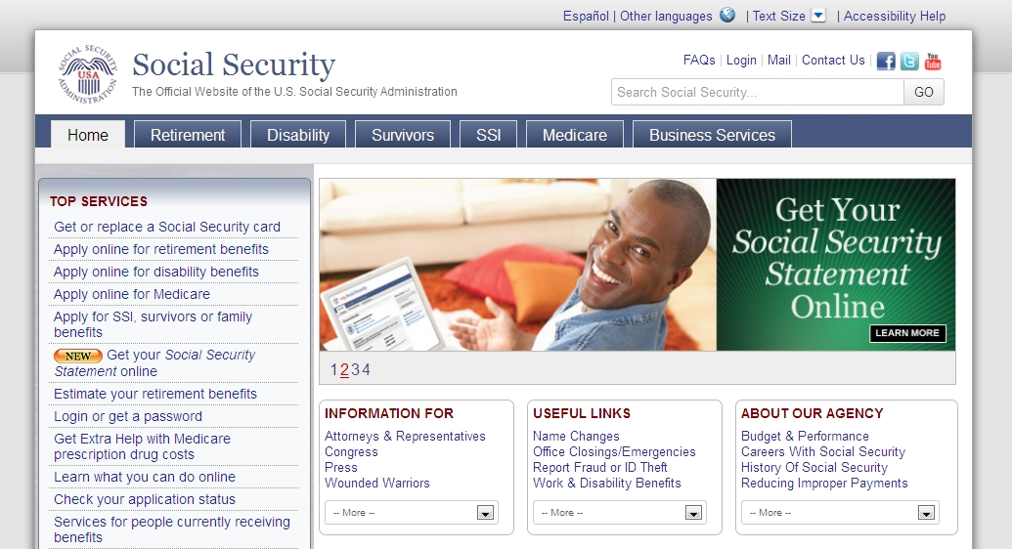
Resources – Social Security
Open a my Social Security account at https://www.ssa.gov/myaccount/

Slide 91
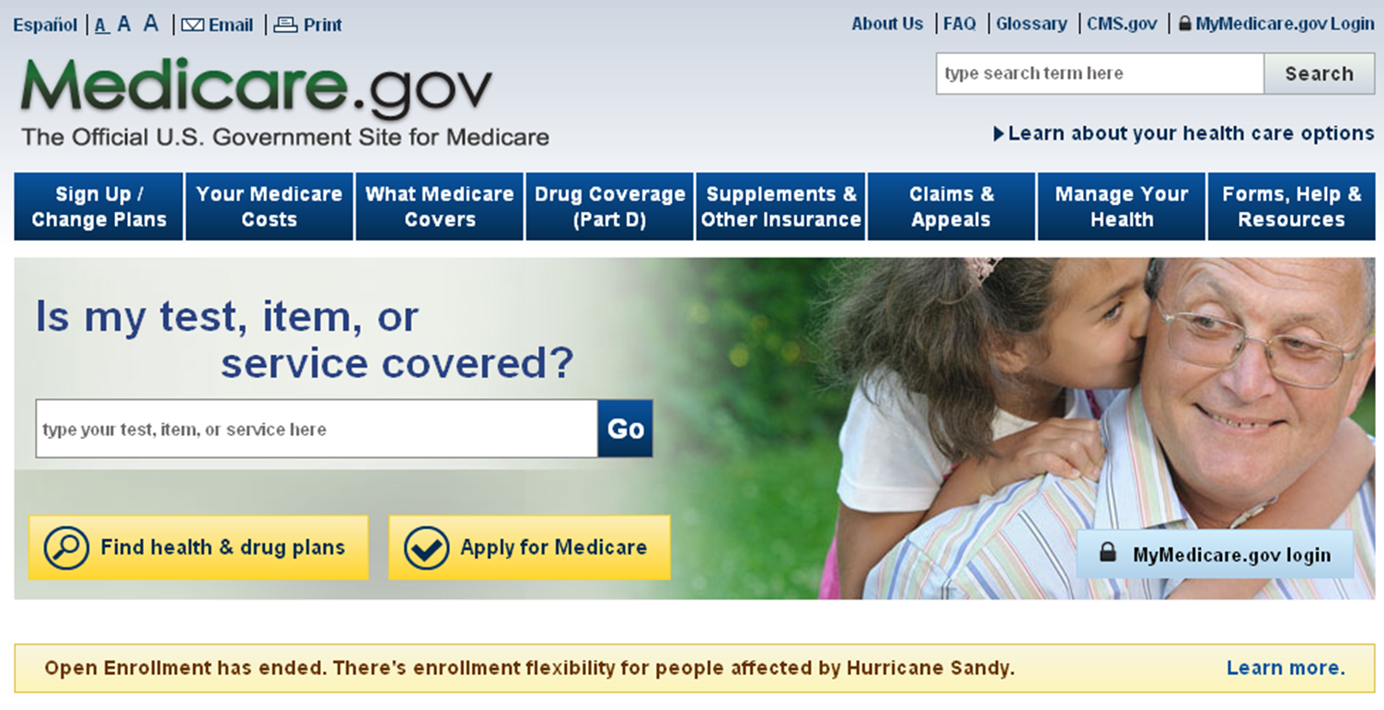
Resources- Medicare.gov www.medicare.gov
Notes:
www.medicare.gov is the official U.S. Government site for people with Medicare. The website is primarily intended for beneficiaries and caregivers. Using the Medicare website, you can:
Compare Medicare health and drug plans
Find a doctor, provider or supplier
Compare the quality of health care providers
Order publications or read them online
Find useful websites, phone numbers and resources
Sign up for MyMedicare.gov
From the homepage, click on the Find Drug and Health Plans link to go to the Medicare Plan Finder homepage. Using this tool, you can find and compare the Medicare health and drug plans in your area.
If you want personalized help choosing a Medicare health or drug plan, contact your State Health Insurance Assistance Program (SHIP). You can find their telephone number on www.Medicare.gov under Forms, Help, and Resources.

Slide 92

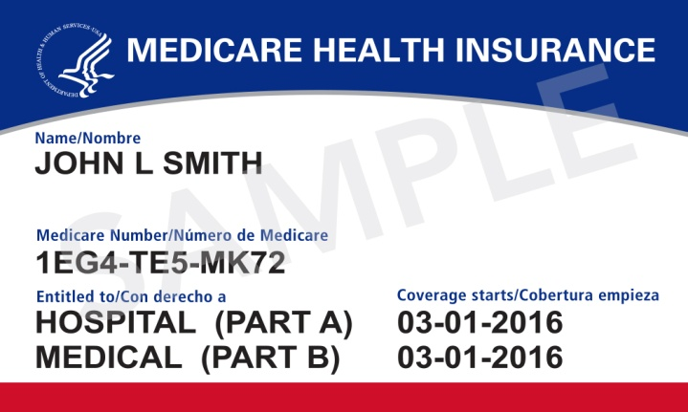
Resources – Find Physicians & Other Clinicians
www.medicare.gov/physiciancompare
  Enter location.
  Search for (Name, Specific group, Body Part, or Condition.

Slide 93

Resources - The Office of the Patient Advocate
Coordinates, provides assistance to and collects data from state health care consumer assistance call centers.
Find ratings of health plans and medical groups in OPA's Health Care Quality Report Cards.
Use OPA's Wizard to get quick links to the consumer assistance call centers and other information that can help you. http://www.opa.ca.gov/Pages/Home.aspx

Slide 94


Review/Personal Medicare List
Start your research early – determine what your specific health care insurance needs are.
If coordinating other health care coverage with Medicare, consult your employer or other health care administrator .
If you want to stay with an existing doctor, find out which insurance plans your doctor(s) participates in.
Make a list of your regular medications and get familiar with Medicare’s Plan Finder on Medicare.gov.
Determine how you want to get your Medicare benefits: Original Medicare or Medicare Advantage?
Decide if you will need to select a Medicare Supplement (Medigap) Policy, and which one you will select.

Slide 95

Review/Personal Medicare List
Enroll in Medicare to avoid Late Enrollment Penalties.
Protect your Medicare card and benefits: Contact Senior Medicare Patrol if you suspect Medicare fraud.
Review your plan selections each year and make changes based on your personal needs.
Contact HICAP for all you Medicare questions

Slide 96

BECOME A HICAP VOLUNTEER
Visit the “volunteer” tab at www.hicapservices.net for more information.

Slide 97
For More Information
LSNC (In Sacramento, 916 551-2150)
Medicare & You Handbook
1-800-MEDICARE (1-800-633-4227)
  TTY Users should call 1-87-486-2048
Health Insurance Counseling and Advocacy Program (HICAP)
  800-434-0222 or 916-376-8915
  www.hicapservices.net
cwashington@lsnc.net
Notes:
More information and help is available:
The Medicare & You handbook is mailed to each household with Medicare each fall. It includes a list of the Medicare health and drug plans available in your area.
The Medicare helpline is open 24 hours a day including weekends. Call 1-800-MEDICARE (1-800-633-4227). TTY users call 1-877-486-2048.
You can also contact your State Health Insurance Assistance Program (SHIP). Their phone number is on the back cover of your Medicare & You handbook, or get it under Forms, Help, and Resources on www.medicare.gov.
Partners can find information from the CMS National Training Program at http://cms.gov/Outreach-and-Education/ Training/CMSNationalTrainingProgram/ index.html

