Slide 1
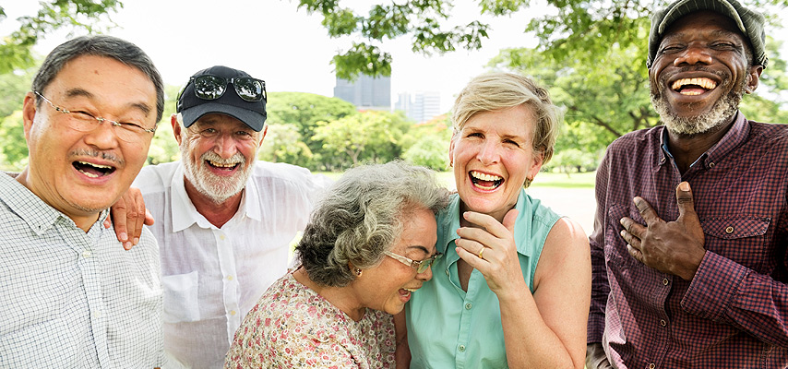
Senior Peer Counseling Program
Our mission is to serve our communities, providing the highest level of care for every patient, every family, every time.

Slide 2
Objectives
To learn about the relationship between SPC and Yolo County.
To achieve a better understanding of the Senior Peer Counseling Program.
To learn about the peer counselor services.
To learn how to identify the ideal volunteer and senior peer client.
How does the SPC Program work ?
How to make a referral?

Slide 3
County Partners
The Senior Peer Counseling Program is supported by the Mental Health Services Act, Prop 63.
The Mental Health Services Act (MHSA) provides a broad continuum of prevention, early intervention and services, and the necessary infrastructure, technology and training elements to effectively support the local mental health services system through California.
Originally the program was through Citizens Who Care Program in 2017.
CWC Merged with Yolo Hospice in 2018.
MHSA Three- Year Program Expenditure Plan FY 2020-2023
Notes:
Prop 63 was passed by California voters in 2004 and is funded by the one percent income tax on personal income in excess of $1 million per year. The prop was created to help expand and transform California’s Behavior Health System to better serve individual who are at risk of , serious mental health issues and their families.

Slide 4
What is Senior Peer Counseling?
Senior Peer Counseling (SPC) is a program that offers free peer-to-peer support to Yolo County residents aged 60+.
Our program matches seniors to a senior peer volunteer who will provide compassionate, informed, and resourceful visits, phone calls, or video visits to those who are overcoming age-related transitions.
Notes:
Some life transitions a client may be experiencing is the loss of a companion new medical diagnosis, retirement, relocation, depression, grief, at risk for isolation, and other health concerns as we age.
SPC meet with their client in their home or anywhere they feel comfortable, for one hour a week. However, due to Covid, clients are finding new ways to communicate by phone, mail. We are encouraging the use of video platforms like Zoom.
3. Senior peer counseling utilizes the skills and life experiences of older adult to provide emotional support to their peers. It allows seniors the opportunity to talk to someone their own age who has experienced similar life challenges and it can be an outlet for someone who understands their concerns.

Slide 5
Services & Volunteers
One-on-one visits with trained peer volunteers.
Transition Support Groups facilitated by the peer volunteers.
Volunteers do not require prior experience or educational background.
Volunteer applicants are asked to commit to a minimum of 3 months to a year.
Volunteers must meet all application requirements all volunteer training.
SPCs are NOT licensed Mental Health Practitioners, but trained listeners with similar lived experiences
Notes:
Senior Peer Counselors meet one - on- one with their Senior Peer at least once a week for a minimum of one hour per week. The visits are made at the peer and volunteers mutual convivence, usually in the client's home.
Visits can include connecting by the telephone or video visits. I have even had client connect by mail during the pandemic.
Support groups are also an option if a senior peer rather meet in a group setting, they can do that also, Those groups are also led by the Senior Volunteers
Volunteers provide caring support, encourage problem identification, and help set goals to help their senior peers live as independently as possible. This program will allow to dig deep with in yourself share with other skills, experiences, and options that you have found useful in your own life.
Volunteers offer meaningful connections, empathetic support, and guidance.
We follow all HIPPA and Confidentiality laws
Helping with short-term goals
Assisting with providing community resources.

Slide 6
The Ideal Senior Peer Volunteer Navigating Life’s transition’s can be difficult. No one should have to do it alone.
Men and women aged 55 and older from diverse backgrounds.
Interested in helping others create short-term goals.
Ability to provide non – judgmental and emotional support.
Good communicator/active listener.
Individuals who can understand different points of views.
The ability to empathize with mental health issues.
Notes:
Someone willing to reach within themselves to share with other seniors the skills and experiences, and options that worked for them in their own lives.

Slide 7
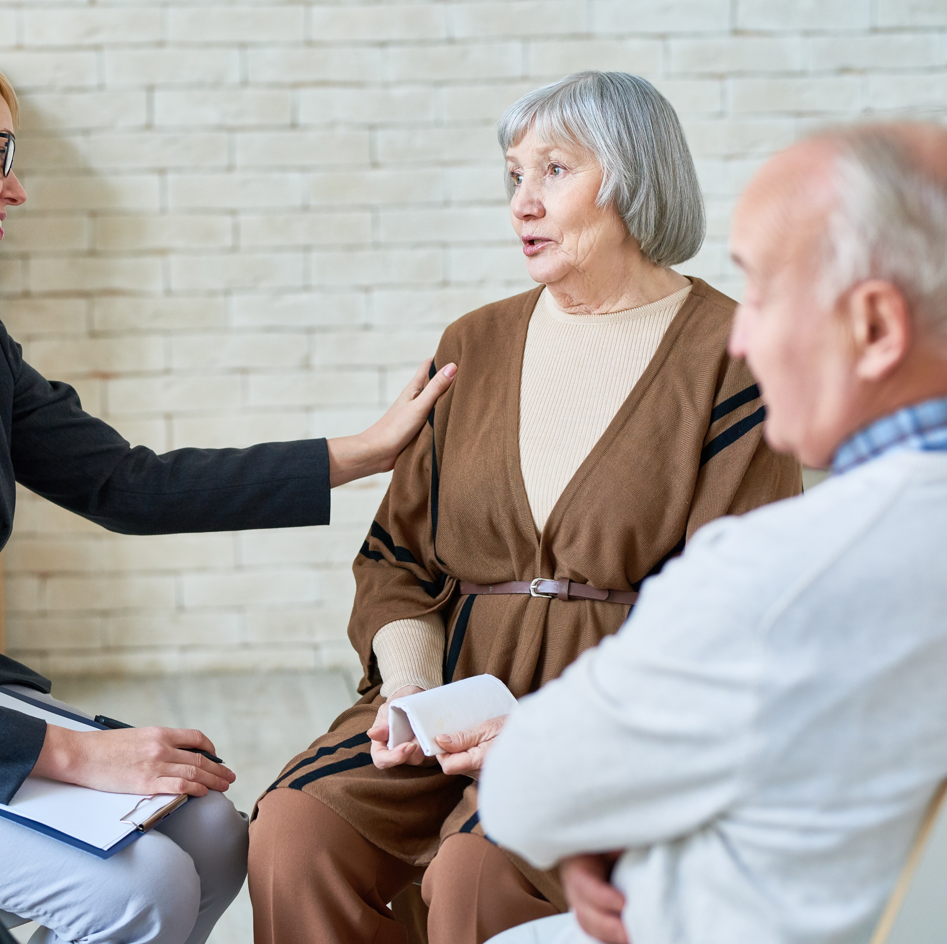
Ideal Senior Peer Client
Are you feeling isolated? Lonely or overwhelmed?
Age Related Transitions:
Retirement
Relocation
Personal Loss
New diagnosis or health concern
Caregiver
Someone in an independent living facility
Feeling lonely, isolated or depressed

Slide 8
How does the Program work?
The Program Director meets with the prospective client to assess appropriateness of program and determine identified goals.
Program Director will discuss case with Volunteers at the bi-weekly Supervision Meeting.
Client are then linked to a volunteer who have similar life experiences.
Volunteer counselors schedule an appointment with client.
meet each week for a minimum of 1 hours.
required to attend Bi- Weekly Supervision Meetings with Program Director.
Keep records and reports hours and the number of client contacts.
Notes:
Referral is made, Program Director meets with prospective client to conduct an assesment on the client and if the client is appropriate, they will be admitted to the program. If they are not, we will refer them to a program that will help meet their needs. A psychosocial assesment is conducted by Program Director Client discusses Goals they may be interested in working on through the Spc program with Director
Client signs informed consent agreement and required county documents as well.
Volunteers are required to get participate in an assesment background check, immunizations, drivers license etc., in addition to a training booklet.
Volunteers attend Bi- weekly Supervision meting allows the volunteer to be involved in the match process by volunteer to take on a client they feel they could take on. Weather is based on different life events, and or shared experiences.
Mention pre covid, Program Director would do the assesment in the home to determine if they were a good fit. We never would send a volunteer to a client's home with our assessing it ourselves.
Since are still dealing with the pandemic we are doing all appointments over the phone. The program Director will conference all them in to create a smooth and warm introduction.

Slide 9
Becoming a Senior Peer Counselor
Sign up as a client or apply to be a volunteer Senior Peer Counselor.
Contact the Senior Peer Counselor
Coordinator at:
Email: SPC@yolocares.org
Call: 530.758-5566
All referrals are confidential and require
the approval of the SPC Coordinator.

