Slide 1
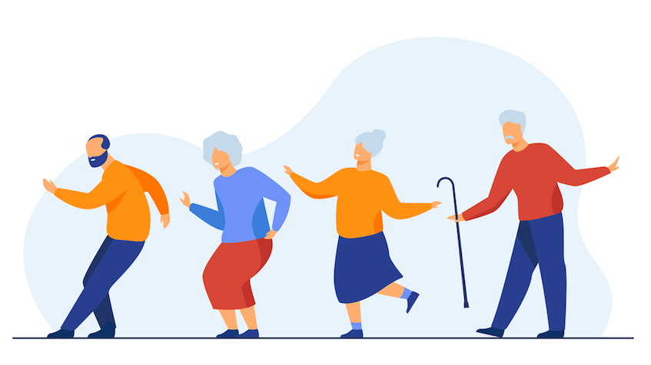
Yolo Healthy Aging Alliance
Fall Prevention Project: Day 1
Notes:
Hello everyone and welcome to the fall prevention projec presented by Yolo Healthy Aging Alliance. Just a quick reminder that today will be the first day fo the webinar and we will be holding the second day tomorrow from 1-2:30. Please join for both days as the second day will have more information.

Slide 2
Introductions:
Dr. Sheila Allen, RN, PhD
Executive Director of Yolo Healthy Aging Alliance (YHAA)
Email: sheila.allen@yolohealthyaging.org
Amal Syed
Master of Public Health student at UC Davis and Intern at YHAA
Email: amsyed@ucdavis.edu
Deborah Eernisse
Personal Fitness Trainer
Email: fitdebtraining@gmail.com
Notes:
Just a few introduction, my name is Amal Syed I was a master of public health student at UC Davis and intern at YHAA. My preceptor was Dr. Shiela Allen who amm might know as the executive director og YHAA, And today we are also lucky to have Deb Eernisse with us today who will be doing live demonstrations of fall prevention exercises and muscle strengthening techniques.
All of our emails are listed on this slide so please feel free to reach out to us at anytime with questions.

Slide 3
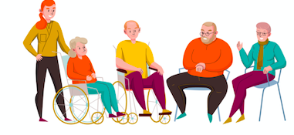
Why is Fall Prevention important?
Our main goal is to reduce preventable hospitalizations and injuries in Yolo County.
Older adults are more susceptible for various reasons.
Though many falls do not cause serious injuries, 1 out of 5 falls DO cause serious injury.
These injuries make it harder for older adults to perform everyday activities.

Slide 4
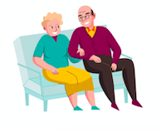
Why is Fall Prevention important?
Falls can be very costly.
A single fall = $30,000
We want to emphasize: Falls CAN be prevented and the impact of falls can be reduced.
Falls do not have to be an inevitable part of aging - we can adopt healthy habits together to prevent falls everyday!

Slide 5
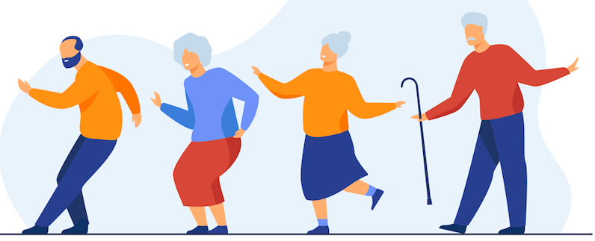
Overcome your “Fall-ophobia”!
Many people who have or have not fallen before become afraid of falling.
This fear may cause you to reduce everyday activities.
When you are less active, you become weaker and this increases your chances of falling.
The best way to overcome Fall-ophobia is to develop confidence in one’s own ability to prevent falls!

Slide 6
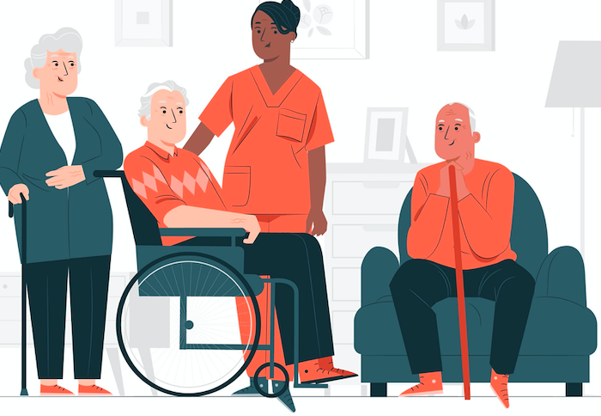
Check in with your healthcare provider!
Regularly check in with a physician to assess your fall risk
If you are at a higher risk, inform your physician that you would like to discuss creating a fall prevention plan
Get regularly screened for osteoporosis and brain illnesses
Make sure to inform your healthcare provider if you have experienced a fall recently.

Slide 7
Risk Predictors of Falls: A Summary of Topics!
Multitasking
Vitamin Deficiencies
Use of certain medications
Vision problems
Orthostatic Hypotension
Environment Assessment and Trip Hazards
Bathroom Safety
Body and Muscle Weakness

Slide 8
Avoid Multitasking:
Older adults are more likely to fall when performing concurrent tasks while walking or running.
It can lead to imbalance, loss of attention, and vision impairment.
Making sure that you have your full attention on your walking surface can help reduce falls!
A 2011 study found that music-based multitask exercise programs can help improve gait and balance while reducing fall risk.
Notes:
The first risk factor we are going to be talking about is MULTITASKING. A recent study found that older adults are more likely to fall when performing concurrent tasks while walking or running. So multitasking can lead to imbalance, loss of attention, vision impairment.
It’s important that you have your full attention on your walking surface. Its also a good idea to not hold too many things when you are walking. Try not to multitask to reduce falls.
Another solution is music-based multitask exercise programs. A 2011 study foundt hat exercise classes like these, like Zumba, can help you improve gait and balance while reducing fall risk. That might be a fun way to get some exercise in and become better at multitasking!

Slide 9
Vitamin Deficiencies:
Deficiencies in Vitamin D, Vitamin B12, and Vitamin K have all been linked to causing falls.
It can lead to increased dizziness, weakness, and blurred vision.
Check in with your physician to have regular blood tests done
Consumption of Vitamin D, B12, and K through diet, supplements, or behavior can increase muscle function and strength.
Notes:
Deficiencies in Vitamins D, B12, and K can cause dizziness, weakness, and blurred vision and can increase your risk for falls.
Vitamin D nutrients help keep muscles healthy. The sun is a natural source of Vitamin D but if you are indoors more than usual, try incorporating cod liver oil, trout, salmon, eggs, and mushrooms into your everyday diet.
Vitamin B12 nutrients can help prevent a type of anemia that can make you feel tired and weak. Vitamin B12 is found naturally in many foods like beef liver, clams, fish, poultry, eggs, and dairy products like milk and cheese.
Vitamin K nutrients are important for healthy bones. Vitamin K is naturally found in many foods like green leafy vegetables, blueberries, figs, meat, cheese, eggs, and soybeans.

Slide 10
Vision Problems:
Visual problems impairs gait and balance and increases fall risk.
Eye diseases like cataracts and glaucoma are associated with falls.
Visit your eyecare provider for a comprehensive dilated eye exam
Almost 90% of blindness is caused by diabetes - set goals to manage your blood sugar, blood pressure, and cholesterol.
Eating dark leafy greens, such as spinach, kale, or collard greens and fish is important for keeping your eyes healthy.
Regularly wear protective and prescription eyewear.
Notes:
Vision problems can greatly increase one's risk for falls by impairing gait and balance. To avoid this:
Eye diseases like cataracts and glaucoma are associated with falls.
Visit your eye-care provider for a comprehensive dilated eye exam.
Be sure to update your eyeglasses to your most current prescription.
Majority of blindness is caused by diabetes - manage your blood sugar, blood pressure, and cholesterol.
Incorporate dark, leafy greens into your diet like spinach and kale.
Use prescription sunglasses when you are outdoors to avoid sun glare.
Avoid using bifocal or progressive lenses when doing outdoor activities, like walking.

Slide 11
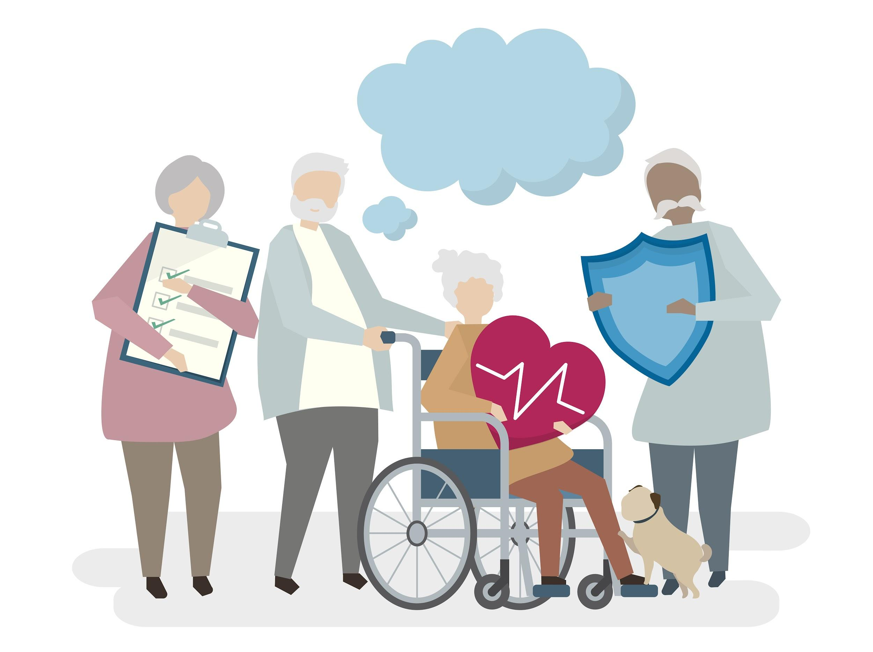
Check your Medications:
Cognitive function medications, mixing certain medication, and over-medication can increase risk of falls.
Impair vision, balance, gait, lead to slower reaction times, dizziness
It is important to regularly review medications and
Stop medications that are not needed anymore
Use alternative medicines when needed
Reduce medications to lower doses when possible
Develop a plan with your provider to reduce impacts of medications like using non-pharmacological medications
Notes:
Certain medications, mixing medications, and over-medications can impair balance, gait, and can lead to slower reaction times, dizziness, and blurred vision.
Check in w you rprovider
Develop a medication plan with your provider to reduce serious impacts from your prescriptions.
STOP medications that are not needed anymore
Assess your health condition with your physician to see if any medications can be stopped.
Use alternative medicine when possible
Research with your physician safer, non-pharmacological alternatives to replace certain medications.
REDUCE MEDICATION DOSAGE
Talk to your physician about lower doses when possible to lessen the impact.
Regulate your medications
Use alarms or spreadsheets to keep track of your medications and reduce the risk of doubling medication.
COMMUNICATE WITH YOUR LOVED ONES OR CAREGIVER
Let your loved ones or caregiver know about your medication plan so they can help you implement it regularly.
Call A doctor before Making any changes
Please do not stop any medications, reduce any dosages, or replace any medications without speaking to a physician or pharmacist first.

Slide 12
Medications Linked to Falls:
Psychoactive Medications:
Anticonvulsants
Antidepressants
Antipsychotics
Benzodiazepines
Opioids
Sedatives-hypnotics
Prescription Drugs, Over-the-Counter medications, & herbal supplements:
Anticholinergics
Antihistamines
Medications affecting blood pressure
Muscle relaxants

Slide 13
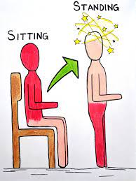
Orthostatic Hypotension:
Refers to a sudden drop of blood pressure
Causes dizziness, blurred vision, or even fainting
Caused by standing up too fast or dehydration
Individuals on certain medications are more vulnerable
Stay hydrated, avoid intense exercise in hot weather, stand up very slowly, and regulate your blood pressure
Notes:
Orthostatic hypotension refers to decreased blood pressure after standing suddenly which causes dizziness, blurred vision, or fainting. Make sure to stay hydrated, steady yourself before standing up slowly, and regulate your blood pressure.

Slide 14
Environmental Assessment and Trip Hazards:
Making your home environment fall-proof can prevent falls.
Falls are often due to trip hazards in your home which are easily overlooked but are simple fixes.
Let’s go through the CDC Check for Safety: A Home Fall Prevention Checklist!
The different factors we will be assessing are:
Floors
Stairs and Steps
Kitchen
Bedroom
Shoes
Lighting
Notes:
Most falls in older adults occur within the home. Making your home environment fall-proof by regularly doing an environmental assessment and removing trip hazards and adding elements that improve safety.

Slide 15
Other Home Safety Tips:
Wear shoes with grip inside and outside of the house.
Improve the lighting in your house.
Paint the edge of all steps and stairs with a contrasting color.
Use double-sided tape to tape your rugs down.
A surprising trip hazard: your pets!
Notes:
Improve the lighting in your house by putting light bulbs in darker areas and using curtains to eliminate sun glare.
Keep an eye on your pets when you are walking to ensure they are not in your path.

Slide 16
Bathroom Safety:
80% of falls in the home occur in the bathroom.
A majority of these falls occur while using the toilet or moving in and out of the tub/shower.
Showering and using the bathroom are essential parts of every individual’s routine
Follow these tips to make your bathroom fall-proof!

Slide 17
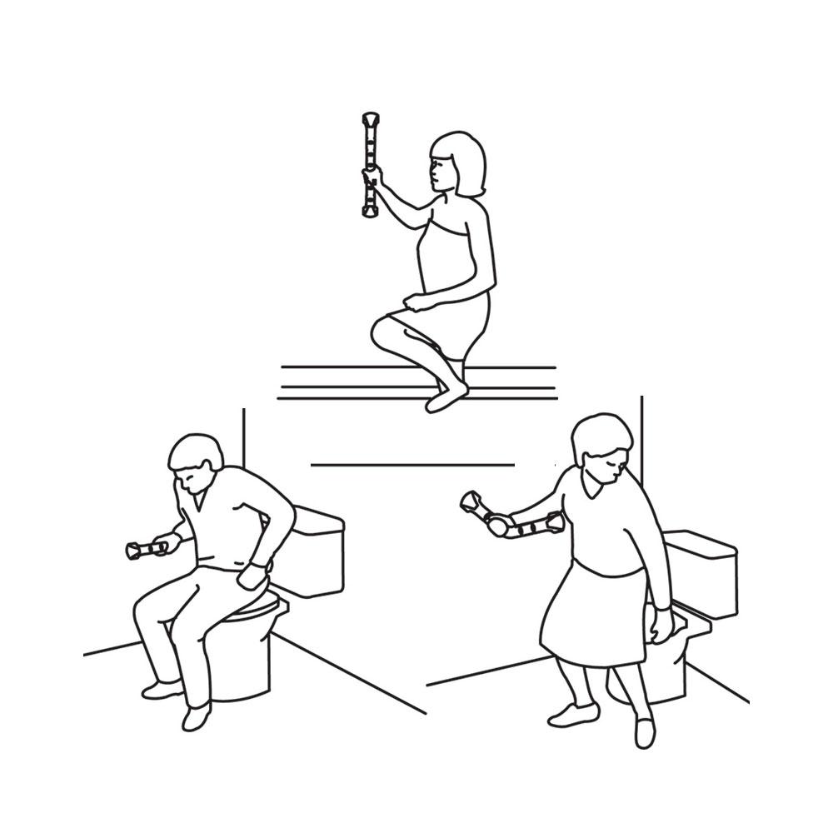
Bathroom Safety Tips:
Install grab bars inside the shower and by the toilet.
Place non-slip mats inside and outside the shower and in front of the toilet and sink.
Use a shower chair with handles, a transfer bench, a raised toilet seat, lower shelving, and nightlights.
Regularly clean wet surfaces to reduce slippery soap scum
Notes:
Install multiple grab bars inside and outside the shower and by the toilet.
Place non-slip mats inside and outside the shower and by the toilet and sink.
Use medical equipment to your needs: shower chairs, transfer benches, or raised toilet seats.
Use lower shelving and accessible baskets to place your bathroom items.
Install nightlights inside & outside of your bathroom.
Regularly clean wet surfaces to prevent build-up of slippery soap scum.

Slide 18
Confidence using Walking & Standing Buddies:
If you feel unstable while walking in your home, try using a walking stick aka your walking buddy!
Using grab bars around the house and in the bathroom can help you complete everyday activities with more confidence and safety.
Decorate and personalize your walking buddies!
Notes:
If you feel unstable while walking in your home, try using a walking stick aka your walking buddy!
It can be a hard transition but in this case, it is better to be safe rather than sorry - using a walker or cane does not have to be something to be embarrassed.
Using grab bars around the house and in the bathroom can help you complete everyday activities with more confidence and safety.
Decorate your walking buddies and grab bars to personalize them and make them your own!

Slide 19
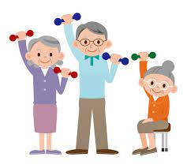
Body and Muscle Weakness:
Avoid falls and maintain balance by staying active!
A previous study found that lower-extremity (legs, ankles, knees) weakness is a primary risk factor for falls.
Muscle tightness and cramps can also lead to falls.
Regular exercises and stretches of lower and upper extremities can strengthen muscles.
Notes:
Regularly exercising strengthens your muscles and maintains your balance.
Strengthen your legs, knees, and ankles by going on short walks everyday.
Stretch in short intervals everyday to prevent muscle tightness and cramps.
Try to do some type of physical activity at least for 15 minutes a day.
Consult with your doctor regularly to find out what physical activity works for you.
Make sure to stay hydrated and take breaks while exercising.
these exercises do not have to be strenuous!

Slide 20
Fit Deb Training Live Demonstration:
Received her bachelor’s degree in Psychology and a minor in Adult Development and Aging from UC Davis
Certified as an Occupational Therapy Assistant through Sacramento City College
Offers practical & innovative ways to help meet varied fitness goals
Works one on one and leads classes online - offers monthly virtual workshops through the Davis Senior Center
Last month’s topic was Pelvic Stability and July’s focus is on the Buttocks
Today and Tomorrow: muscle strengthening and flexibility techniques
Notes:
Also after fit deb’s presentation please stick around as we will be taking any questions you all have.

Slide 21
Yolo Healthy Aging Alliance Fall Prevention Presentation: Day 2
Notes:
START W DEB
How to fall properly
How to get up from falls properly
How to move for help if arm is injured
How to move for help if leg is injured

Slide 22
Tell your caregiver and doctor after falling:
Fall prevention is a team effort!
Inform your doctor or a medical professional after a fall
Many injuries can be undetected and it’s better to treat them as early as possible.
Let your family or caregiver know - communicating falls or a fear of falling can help them help you.
Notes:
Fall prevention is a team effort!
Inform your doctor or a medical professional after a fall even if feel like you are not injured
Many injuries can be undetected and it’s better to treat them as early as possible.
Let your family or caregiver know - communicating falls or a fear of falling can help them understand how to help you create a fall prevention plan.

Slide 23
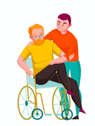
Things a caregiver should do:
Reach out to your loved one to find out if they have Fall-ophobia - develop a fall prevention plan with them.
Find out if there are any aspects of their health and lifestyle that are giving them problems.
Ask about their last eye check-up, encourage them to get a eye exam, see if there prescription is current.

Slide 24
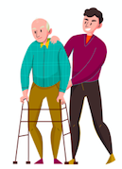
Things a caregiver should do:
Notice if they are using walls or furniture to stabilize themselves/help them walk.
Help them create spreadsheets or alarms to keep track of their medications.
Do a walk-through environmental assessment of their home to ensure that there are no trip hazards.
Notes:
If they are, encourage them to use canes or walkers.

Slide 25
Medical Alert Systems:
Medical Guardian System: provides both fall detection GPS technology and connection to a monitoring and response center with a button.
Price = $39.95 per month or $37.45 paid annually
Promotional Code FEELFREE for a free month and free shipping
Bay Alarm Medical System: provides connection to a monitoring and response center both in and out of the home using WiFi.
Price = $19.95 per month and provides a 30-Day Risk Free Trial
MobileHelp: provides a fall detection button on its devices which connects to a monitoring and response center in-home.
Price = $19.95 per month
Provides free shipping and 2 free months

Slide 26
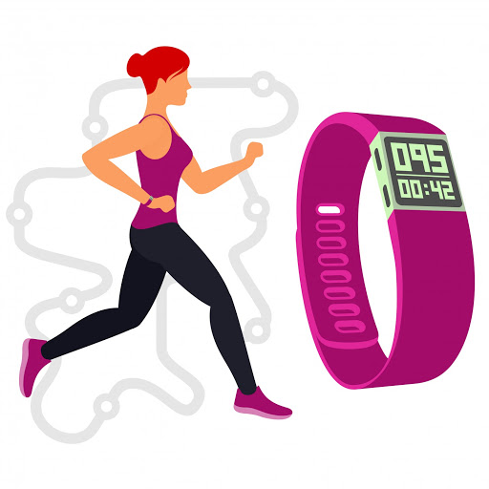
Fall Detection Systems:
Bay Alarm Medical and Medical Guardian double as both alert systems and detection devices.
MyNotifi: most cost-effective combined fall detection and alert system with no monthly fees. Worn through a belt clip or wristband and can sync with your or a family member’s smartphone.
Price: $199 one-time payment
Apple Watch Series 4: can detect a hard fall, play a loud noise, sends messages to your emergency contacts and emergency services.
Price: $279 - can be a one-time payment or monthly payment plan.
Notes:
Fall Detection Systems use technology to sense any sudden movements or falls to notify a response agent

Slide 27
Noise-Making Devices:
If you do not want fall detection or medical alarm systems, you can keep noise-making devices with you to call for help if a fall occurs.
The Apple Watch automatically emits a loud noise when a fall is detected.
Birdie Personal Safety Alarm: small handheld device that emits a loud siren and flashing strobe light when pulled.
Price: $29.99
On-sale for $26.95 until the end of May

Slide 28
Resources for Free Medical Equipment:
Some Medicare and Medicaid packages will reimburse or cover the cost of medical alert systems if you provide a doctor’s note.
Davis Senior Center Medical Equipment Closet: provides free walkers, canes, shower chairs, and other medical equipment.
You do not have to live in Davis to use this program.
Contact Information: 1-(530)-757-5696
Student-Run Clinics like Knight’s Landing One Health Clinic and Communicare may also provide free walking equipment.

Slide 29
Resources for Home Modifications:
Medicare Benefits: Many Medicare packages will pay for bathroom modifications and walk-in tubs if you are at a high risk for falls.
Department of Veterans’ Affairs: apply for the Specially Adapted Housing Grant, Special Housing Adaptation Grant, and the Home Improvement and Structural Alteration Grant
Habitat For Humanity: volunteers can install grab bars or other small modifications in home
Davis Odd Fellows Senior: provides grab bar installation and other home modification help
Woodland/Winters Kiwanis Handy Helpers: provides minor home repairs.

Slide 30
Resources for Free Health-Care:
For Yolo County, Knights Landing One Health Center is open on First and Third Sundays of the month.
Services include immunizations, diabetes and hypertension treatment, blood tests, regular physical check-ups, and eye exams.
For a full list of student-run clinics in the Sacramento and Yolo County, please visit https://health.ucdavis.edu/mdprogram/studentlife/clinics/

Slide 31
Resources for Free Health-Care:
Communicare: located in Davis, Woodland, and West Sacramento provides comprehensive, non-emergency, primary care services.
Services include general physical exams and well visits, cancer screening, TB testing, dental care, and hypertension care and diabetic treatment.
Contact Information: 1-(530)-285-3201
Winters Healthcare Medical Clinic: provides medical, dental, and behavioral health services
172 E. Grant Ave. Winters, CA
Contact Information: 1-(530)-795-4377

Slide 32
Any questions or comments for feedback?
Thank you for listening!
Please type your questions in the chat-box!

