Slide 1


Fall Prevention Workshop
Sheila Allen, RN, PhD, Public Health Nurse
Executive Director, Yolo Healthy Aging Alliance
With thanks to Lisa Musser, RN, PHN, former Yolo County HHSA, Healthy Aging Program Director

Slide 2

The scary statistics
Leading cause of accidental deaths in people 65+
Most common cause of ER visits for people 65+
40% of those hospitalized do not return to
independent living
Question: How many people fall every year?
        a. 1 in 10
        b. 1 in 5
        c. 1 in 3
Question: Who falls more often men or women?
Notes:
1 in 3
Women. And Women are 2x more likely to break a bone but men more likely to die in a fall. 46% more likely.

Slide 3

Do you or someone you know have “fallophobia”?
Have you fallen in the past?
Are you afraid that you may fall again?
Fallophobia can lead to more falls and more health problems.
Fallophobia can cause you to limit your activities, become weaker and socially isolated.
Contact your health provider.
Notes:
Tell your doctor or health care provider that you fear falling. A yearly fall prevention screening is reimbursed by Medicare.

Slide 4
Why do older adults fall?
There is normal aging of the body:
  Decreased muscle strength and reflexes
  Worse balance and coordination
  Impaired vision and hearing
More likely to have health conditions:
  Diabetes, heart disease, arthritis, stroke
Notes:
Poor lighting, slippery floors, throw rugs, papers, clutter, cords, steps, cracks, uneven surfaces.

Slide 5
Why do older adults fall?
More likely to have poor nutrition and hydration
Insufficient calories and nutrients can cause weakness
Insufficient water can cause weakness, dizziness or fainting
Less efficient metabolism causes an increased effect of alcohol
The environment has hazards
Medication side effects and interactions
Notes:
Poor lighting, slippery floors, throw rugs, papers, clutter, cords, steps, cracks, uneven surfaces.

Slide 6
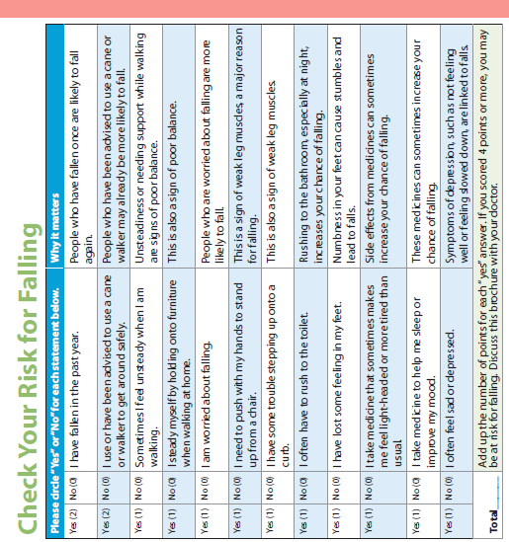
What to do to beat the odds?
Check your personal risk factors with your doctor and treat your health problems.
Four things are really important
  - Exercise
  - Review the medicines you take
  - Check your vision
  - Make your home safer
1
2
3
4

Slide 7
Notes:
Let’s take a minute to do a self-assessment now – I would like you to answer the questions on this self- assessment.
You do not have to share and I will not collect it. This is for you to have and to share with your doctor.
If your score is more than 4 indicates you should talk it over with your doctor to get individual advice.
What can your doctor do for you? A few things.
May ask you more questions and uncover a health problem that you didn’t know you had. May run some tests. Can help you treat your health problems that may have caused these symptoms.
May have advice for managing your personal health conditions.
May refer you to a physical therapist or an occupational therapist to get individual advice about strength training or teach you how to use assistive equipment like canes or walkers.
Besides your individual risk factors. There are some basic things that we all can do to reduce the risk of falls. CDC focuses on four things and we’ll talk about each one.

Slide 8

1
Begin an exercise program to improve your leg strength and balance.
1
Notes:
The first thing you can do to reduce the risk of falling is get stronger. Physical activity, exercise will make you stronger, improve your balance and coordination and will help you feel happier and more energetic. This can be walking on your block, at the park or just around your house. This can be an exercise at the senior center or at a local gym or this can be some simple exercises at home. What you do depends on your level of fitness already, your ability, your personality and your motivation.
Q - Then ask one or two individuals on each team to describe what they do, how it makes them feel and what benefits they feel they get.
There are different kinds of exercise/physical activity. All good and ideally you get a little bit of all these kinds.
Aerobic builds stamina
Stretching builds flexibility
Weight bearing builds strength.
For falls prevention the most important are strength and balance.
Two easy exercises that build strength and balance:
Chair Rise
One leg stand

Slide 9

2
Ask your doctor or pharmacist to review your medications.
Notes:
Including the ones that don’t require a prescription. Some medicines, or combinations of medicines, can make you drowsy or dizzy, which can lead to a fall.
Q - In the past 12 months, has your doctor or pharmacist to reviewed all of their medications to make sure that there wasn’t a dangerous combination or a mix that might increase their chances of falling?
Don’t stop taking what you have prescribed but check with your doctor or pharmacist to make sure they are safe for you.
So things that make you dizzy or fuzzy headed can increase your risk of falls. What else might make you dizzy or fuzzy headed?
Lack of sleep
Alcohol
Getting up quickly – postural or orthostatic hypotension

Slide 10
Medications that increase fall risk
anti-hypertensives – for blood pressure and certain other heart medications
muscle relaxers
medication for anxiety and antidepressants
over the counter antihistamines that have diphenhydramine or (Benadryl, Aller Chlor, Chlor-Trimetron)
over the counter sleep aids that have diphenhydramine (Tylenol PM)
antipsychotic medications

Slide 11

3
Get your vision checked annually and update your eyeglasses.
Notes:
The third thing you can do to reduce your risk of falling is make sure you have your vision checked regularly. As you all know, your vision changes over time. If you haven’t had your eyes checked recently, you should. Poor vision certainly increases the chances of tripping over things or failing to see a curb or step, leading to a fall. Bifocals are sometimes problematic too because they can distort your vision of the ground.
Also is a good idea to having hearing checked annually.
Q - In the past 12 months, how many people have had their vision checked by a professional?

Slide 12
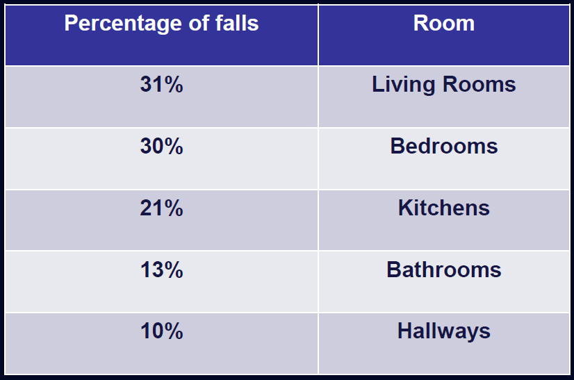
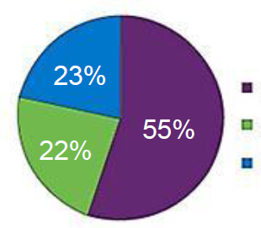
Where do falls take place?
In the home
Outside but near the home
Away from the home
Notes:
So most falls happen in environments that are very familiar and that you have a lot of control over.

Slide 13

4
Make your home safer. Ask someone to help you check.
Notes:
So the 4th thing you can do to prevent falls is to make your home safer.
There are many things you can do to make your home safer. We have given you a home safety checklist. We’ll review these briefly, but it’s very important that you discuss this list with a family member, care provider or anyone else who can work with you to go through this checklist and make the changes that will make your home safer and reduce the chances of you falling.

Slide 14
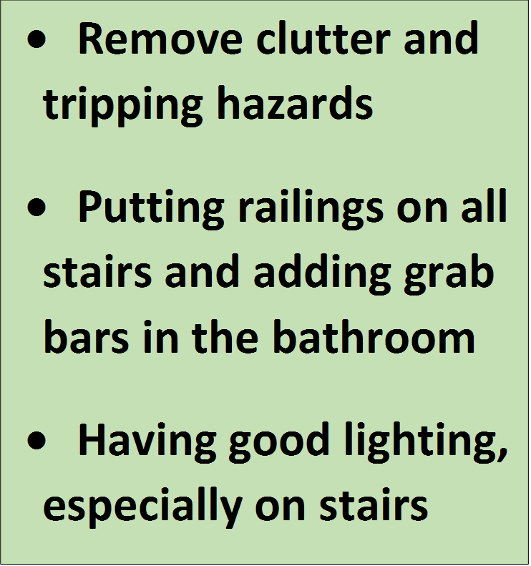




Living room Kitchen Bedroom Bathroom Stairs
Notes:
Do you think doing any of these things would be a good idea in your home?
- Remove things you can trip over, such as papers, books, clothes and shoes
- If you have stairs, make sure they are free from clutter, are well lit, don’t have any broken steps, and have good handrails
- Remove small throw rugs or use double-sided tape to keep rugs from slipping
- Keep items you use often in cabinets or shelves you can easily reach without using a step stool
- Have grab bars put in next to your toilet and the tub or shower
- Use non-slip mats in the bathtub and on shower floors
- Make sure you have good lighting in your home. Replace broken light bulbs. It’s especially important to have good lighting when you are going from your bed to the bathroom.
Many falls happen because people trip on their way to or from the bathroom at night. Nightlights in your bedroom and bathroom are a good idea.
- Avoid walking around in slippers or just your socks or stockings. Wear shoes that give good support and have nonslip soles. Keep a working flashlight near your bed for emergencies.
Q – Other ideas?
Every room has its hazards.
Living room: Remove throw rugs, clear away clutter, potiohn the phone conveniently, remove cords and wires, make sure there is lots of good light
Kitchen: Place frequently used items within easy reach, invest in a steady step stool, don’t take short cuts, keep floors dry
Bedroom: Install night-lights, maker sure you can reach a light from bed, make sure you can reach a phone from bed
Bathroom: Put a non slip surface on the tube or shower, install grab bars, add booster to the toilet, consider a stool or walker in the shower
Stairs and steps: remove clutter, fix uneven or broken steps, add lights to the staircase, make sure carpet is not loose or torn, make sure handrails on both sides are good

Slide 15

What if you fall?
Notes:
Poor kitty.

Slide 16
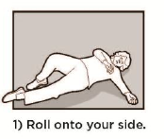
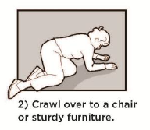
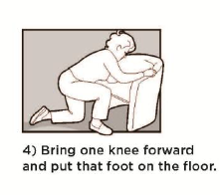
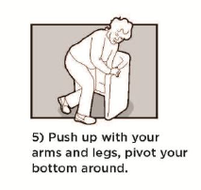
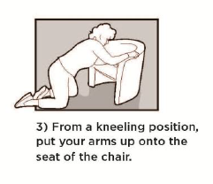
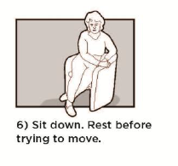
Video
Video
Practice how to get up from a fall.
Calm down
Check your body
If you are injured call for help
If not, look for a sturdy piece of furniture, couch or chair
Notes:
How to Get Up From a Fall Top Video is by yourself Bottom Video is helping someone else
•Locate a sturdy piece of furniture
•Roll over onto your side
•Push your upper body up
•Crawl on your hands and knees
•Put your hands on the chair seat
•Bring one knee forward and put that foot on the floor.
•Push up with arms and legs and slowly rise from kneeling.
•Pivot you bottom around to sit in the chair.
•Regain your composure
If you would I have these pictures on a handout for you to take home.

Slide 17
Video
Video
What if you can’t get up or are hurt?
Cry out, yell
Bang away
Slide over to the telephone and call 911
Use your emergency call device
Get into a comfortable position and wait
Notes:
How to Get Up From a Fall Top Video is by yourself Bottom Video is helping someone else
•Locate a sturdy piece of furniture
•Roll over onto your side
•Push your upper body up
•Crawl on your hands and knees
•Put your hands on the chair seat
•Bring one knee forward and put that foot on the floor.
•Push up with arms and legs and slowly rise from kneeling.
•Pivot you bottom around to sit in the chair.
•Regain your composure
If you would I have these pictures on a handout for you to take home.

Slide 18


Four important things to do prevent falls and stay independent
3
4
* And you did a self-assessment that you can share with your doctor
Notes:
There are many things you can do to make your home safer. We have given you a home safety checklist. We’ll review these briefly, but it’s very important that you discuss this list with a family member, care provider or anyone else who can work with you to go through this checklist and make the changes that will make your home safer and reduce the chances of you falling.

Slide 19



Adapted from: CDC STEADI Stopping Elderly Accidents, Deaths & Injuries Materials for Health Care Providers from: CDC.gov/homeandrecreationalsafety/Falls/steadi/materials.html
Material also adapted with permission from Lori Eber, JD, Gerontologist, How to Prevent Falls Community Education Event: May 16, 2012
Exercises from NIH Go4Life from: https://go4life.nia.nih.gov/
How to Get up for the Floor adapted from Alberta Health Services handout
Thank you!

