Slide 1
California Health Collaborative (CHC) Multipurpose Senior Services Program (MSSP)
Building Partnerships
Promoting Wellness
Changing Lives

Slide 2
Multipurpose Senior Services Program (MSSP) Overview
Statewide, there are 38 MSSP sites serving 48 counties
1915 (c) Waiver - Federal funding with a State match
California Department of Aging oversees the program
Two sites at CHC serving Sacramento, Placer, Yolo, and Yuba Counties (Yuba – 52; Placer, Sac, Yolo – 276)
Case management , care coordination and advocacy services to frail and low-income seniors
Goal is to keep seniors safely at home for as long as possible
Voluntary program - participant may cancel services at any time

Slide 3
Multipurpose Senior Services Program (MSSP) Overview
Waitlist by county – currently Yolo County has a very small waitlist
MSSP collaborates with other providers as long as there is no duplication of services:
IHSS,
Alta-Regional Center,
VA,
RIL,
Hospice
Can not receive MSSP and In-Home Operations, Assisted Living, Home & Community-Based Alternatives, or AIDS Medi-Cal Waivers, or PACE.

Slide 4
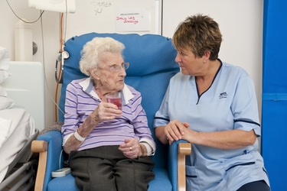
Who is eligible for MSSP services?
A frail senior who:
is 65 years of age or better
receives Medi-Cal benefits with an
eligible aid code(s)
1E, 2E, 6E, 10, 14, 16, 1H, 20, 24, 26, 60, 64, 66, 6H, 1X & 1Y
SOC with eligible aid code must be spent down before Waiver funds used
is at risk of nursing home placement
requires assistance with at least 3 ADLs (eating, bathing, dressing, transferring, toileting, grooming, medication management and mobility).
MSSP also provides information on services/resources to non-MSSP participants as needed, following a “no wrong door” philosophy.

Slide 5
MSSP Scope of Services
Enrollment Process
Social Work Care Manager: In-home psychosocial assessment addressing psychosocial issues & social determinants of health
RN Care Manager: In-home health assessment and in depth medication review
Development of individualized care plan and coordination of services
Minimum of monthly telephone contacts
Minimum of quarterly home visits
Annual visit by Nurse Care Manager to assess Level of Care

Slide 6
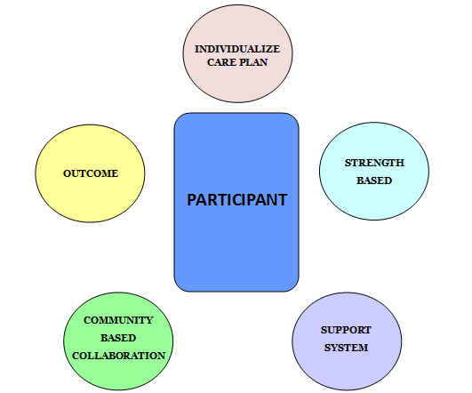
Person-Centered Care Plan
Identify strengths, voice & choice, based on identified needs, person-centered
Remain living at home safely
IHSS, MDs, MOWs, APS, LSNC, Home Health, ADHC/CBAS
Family, friends, church, pets, informal CGs

Slide 7
MSSP Waiver Funding/Services
Safety equipment/environmental accessibility adaptations: grab bars, ramps, non-skid mats, transfer poles, etc.
Transportation: taxi, Paratransit, gas cards, etc.
Personal care & hygiene products: no-rinse wash, gloves, wipes, sprays, etc.
Supplemental personal care: chore work services, bath service, etc.
Personal Emergency Response System (PERS): ERS, fall detection, GPS locator, etc.
Minor home repairs/modifications: Handyman services/contractor, gutter cleaning, adaptations, etc.
Non-Medical Home Equipment: furniture, microwaves, A/C, fans/heaters, utensils, etc.
Waiver Funds are used as a supplement and have a spending limit.

Slide 8
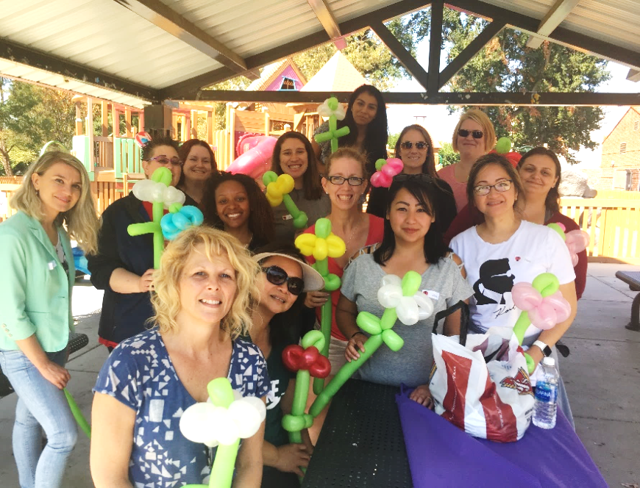
MSSP Case Management Staff
Registered Nurse Care Managers – 3 part-time
Current RN license & experience
Social Work Care Managers – 7
Min. BA in social service related degree & 2 years experience
Interns/Volunteers
BSW, MSW, Gero, BSN
Administrative Staff
Billing Specialist
Program Assistant
Supervising Care Manager
Asst. Site Director
Site Director

Slide 9
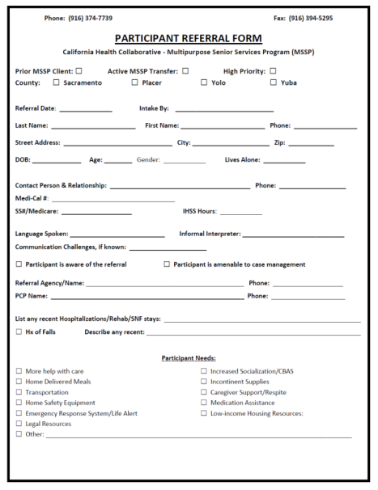
Referral Process
Anyone can make a referral
By phone: 916-374-7739
By fax: 916-394-5295
By email: svue@healthcollaborative.org

Slide 10
QUESTIONS?

