Slide 1
YHAA Intern project: Veterans resource guide
Ali Padua, CSUS Gerontology Intern
Supervisor: Sheila Allen, RN,

Slide 2
To address the lack of information, resources, and services provided for veterans. -Make information accessible for veterans (especially the older veterans). -Inform of these resources and services for veterans. -Help veterans get the extra assistance.

Slide 3
A lot of veterans know about the basic health care and education benefits but they’re not aware of other programs that can provide more help. These not well-known programs can improve the lives of veterans and help ease the financial burden of medical care or other expenses. Yolo Co. had an estimate of over 7,600 veterans in 2019.
Why is it important?

Slide 4
Programs and Benefits
VA Nursing Homes, Assisted Living, and Home Health Care
Services include 24/7 nursing and medical care, physical therapy, help with daily tasks, comfort care and help with management, and support for caregivers. Care settings may include nursing homes, assisted living centers, and adult health centers.
VA Home Improvements and Structural Alterations
Home Improvement and Structural Alterations provide medically necessary improvements and/or structural changes to the veteran’s residence, such as modifying entrances or exits and improving plumbing or electrical systems.

Slide 5
Connecting Veterans to Resources
Self services through multiple websites
Yolo County Veterans Services Office (by phone-soon in person)
UCD Veterans Services for UCD students
Assistance through YHAA
Website
Flyer

Slide 6
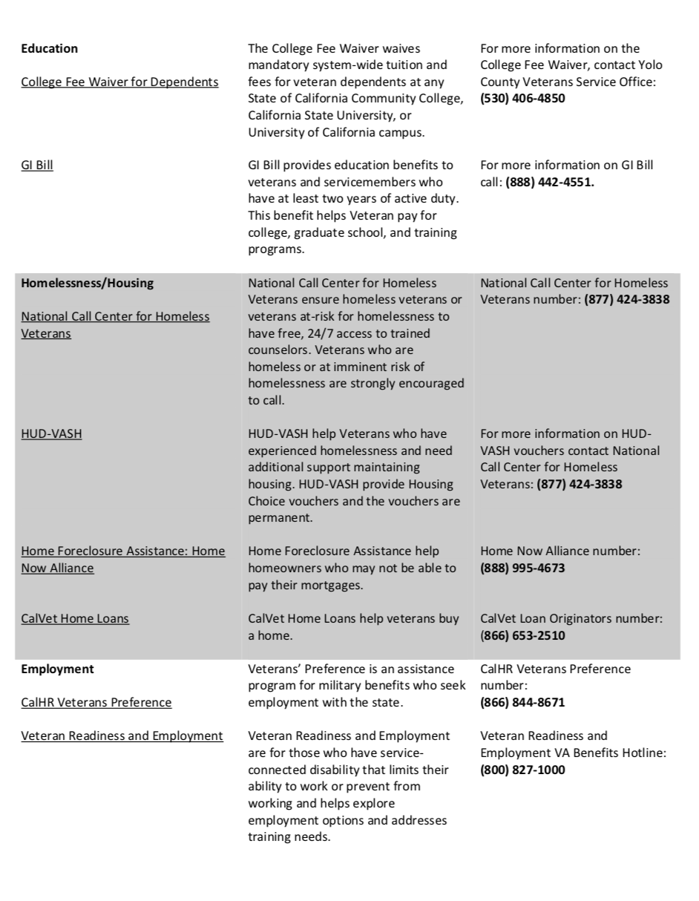
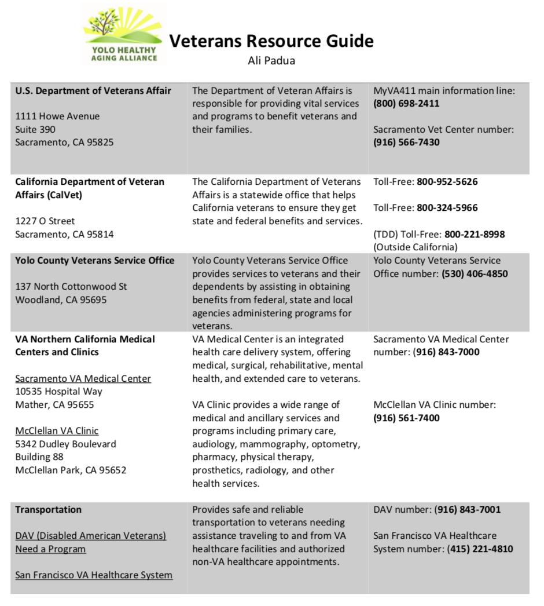
Flyer

Slide 7
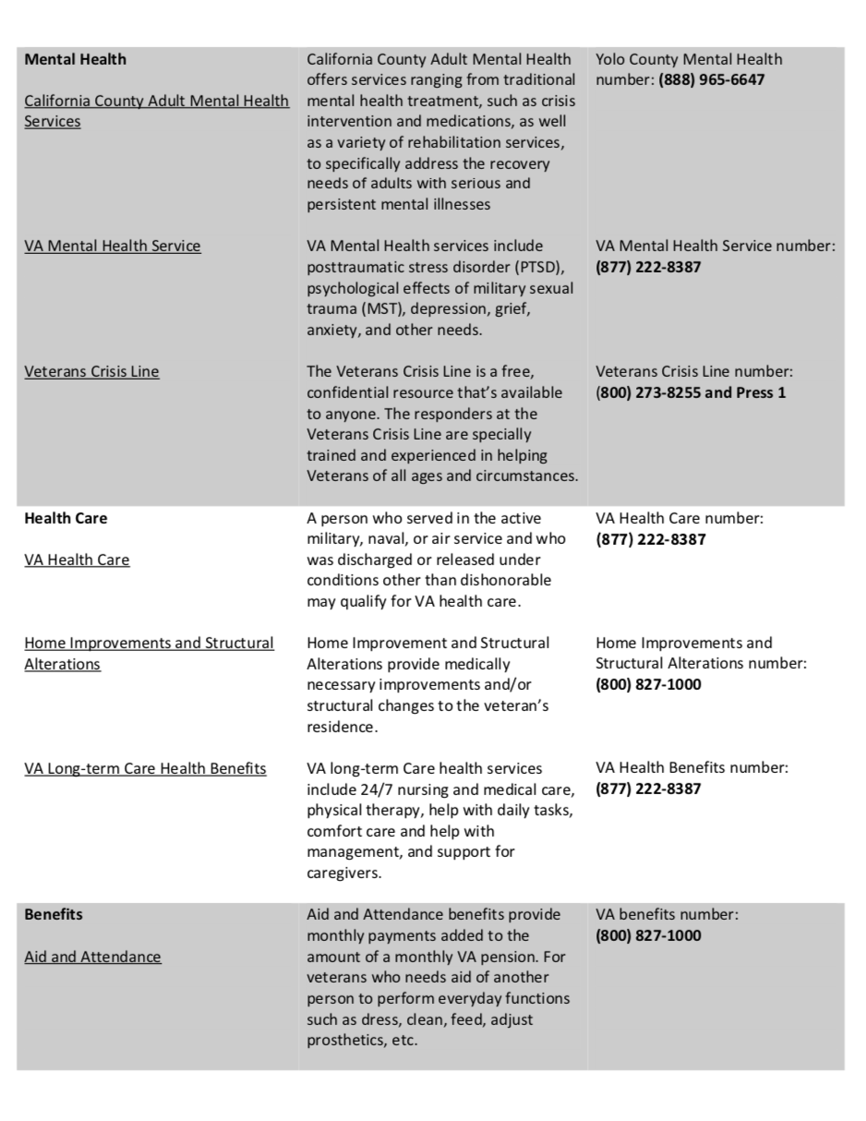
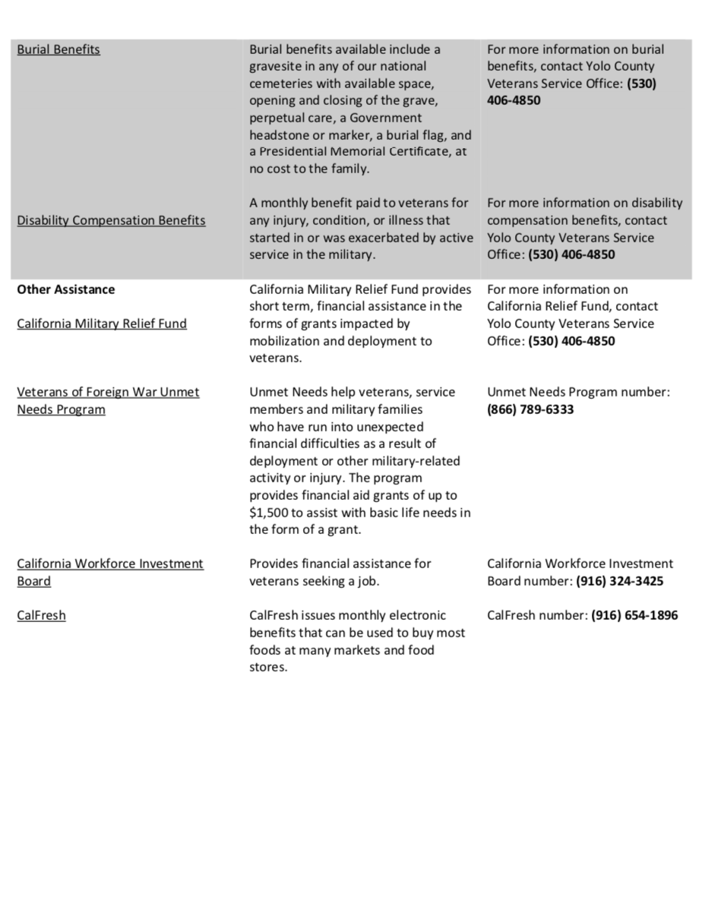
Flyer

Slide 8
Thank you to the Collaboration Committee members and YHAA for connecting veterans to services. Thank you also to: Julia Baumgartner, Volunteers of America, Omega Lee, UCD Veteran Success Center & Sal Torres, Yolo County VSO for contributing to my project.

